Slide 1
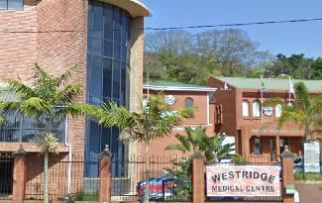

Contrast-Enhanced Spectral Mammography- CESM
An Overview
Contrast-Enhanced Spectral Mammography-
CESM
An overview

Slide 2


Today Mammography remains the most
relevant exam to address
High satisfaction
Easy positioning, efficient exam
time/process, clear results
Good image quality
Reasonable dose, repeatable,
breast
cancer
screening
standardized, reliable
Smooth workflow and connectivity
Review station, archiving, connectivity
Proven clinical outcomes
DMIST, OSLO II: better sensitivity
overall and specifically on dense breast

Slide 3
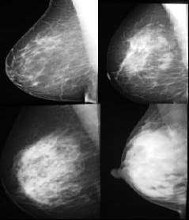
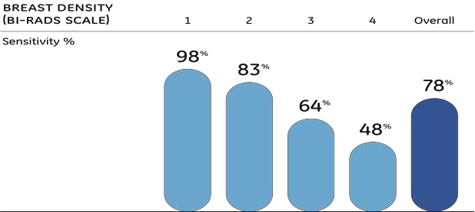
Mammography is a reliable
tool,
but
has
limitations
Dense breast tissue can overlap with lesions
Lesions are not always visible with x-ray
Interpretation
of
images
can
vary
among
radiologists
Kolb et al. Radi ol ogy 2002; 225:165-175.

Slide 4
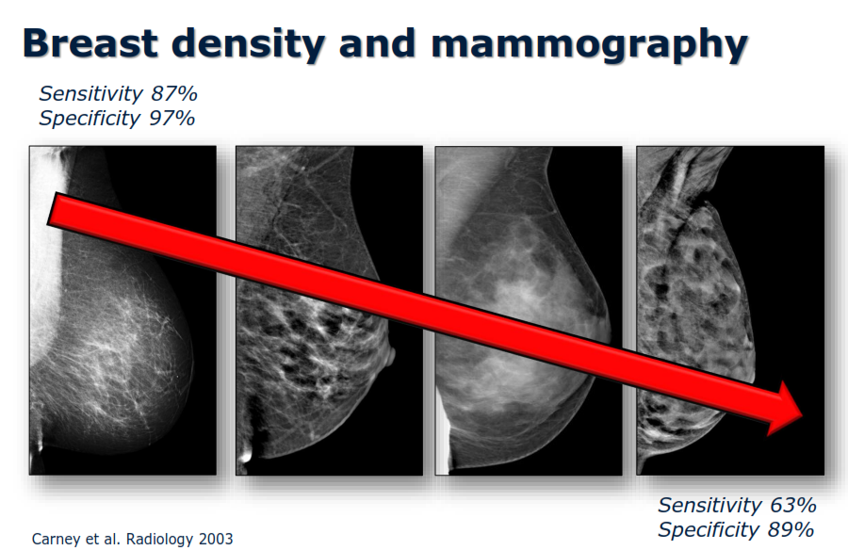

Slide 5
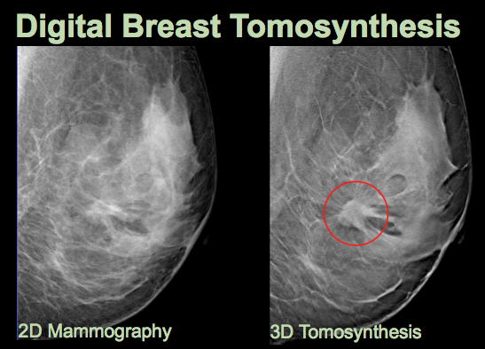
Tomosynthesis
Like tomography, the basic idea is that in plane structures are in focus, out of plane structures blurred
Unlike tomography, reconstruct a number of different projections to get a series of images through the volume (like CT)

Slide 6
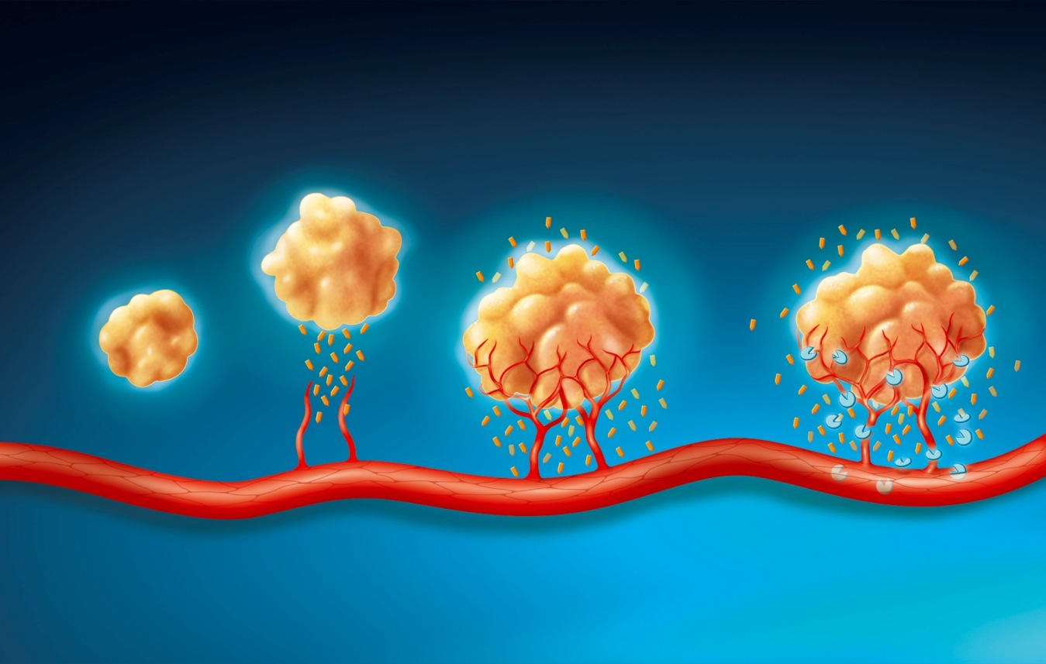
One potential solution: Leverage other types of signals known to indicate the possibility of cancer.
Angiogenesis, the growth of new blood vessels, occurs around cancers
Contrast agents arrive in tissues affected by these new vessels, and can help to visualize these lesions
Modalities like MR and CT use contrast-enhanced imaging to detect angiogenesis
use contrast agents in digital mammography to enable visualization of contrast uptake
Notes:
While digital mammography gives very high resolution images of the structure of the breast, there are other ways besides just morphology for detecting possible cancers. One of these other types of “markers” is the growth of new small low quality blood vessels which often grow around cancerous tumors. These vessels tend to be poorly developed, and contrast agents leak into the interstitial spaces. This is how MR works.
The paradox is that mammography systems have been built specifically for breast imaging, yet as soon as we have the need for a more in-depth test, the patient is sent off to another modality. So the challenge for GE has been to make this same type of contrast enhancement signal available in digital mammography.

Slide 7
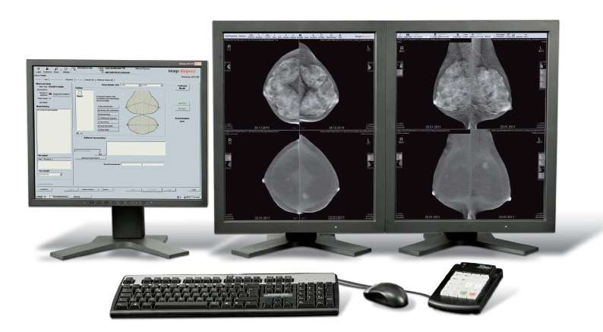
Contrast-Enhanced Spectral Mammography- CESM
Contrast-enhanced Spectral mammography (CESM) is a new breast imaging technique
using full-field digital mammography in conjunction with the intravenous (IV) injection of an iodinated contrast medium.

Slide 8
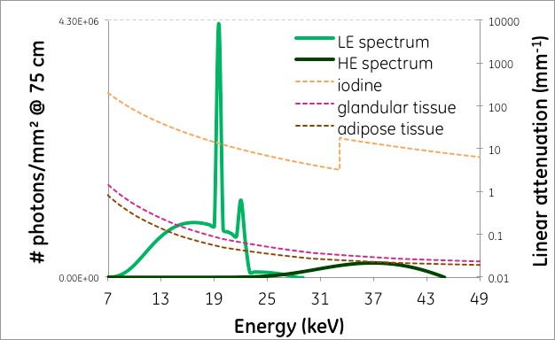
Typical LE and HE spectra used with Senobright and attenuation of
breast tissue and iodine as a function of x-ray energy

Slide 9
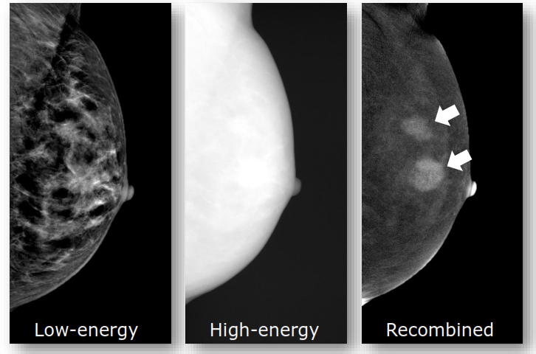
CESM
Photographic “red-eye reduction” uses multiple flashes to reduce red-eyes. CESM uses x-rays at multiple energies to reduce background signal.

Slide 10
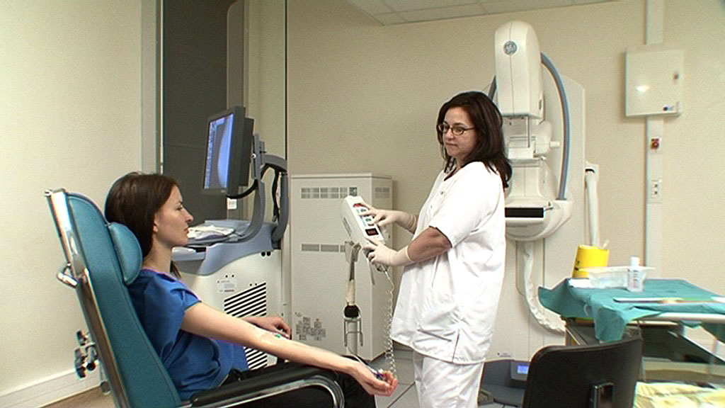
How easy or difficult is the procedure
to perform?
  IV injecton of contrast, and takes about 10 minutes in total.
  From the radiographer’s and patient’s point of view, the exam consists of an intravenous injection of iodinated contrast agent similar to CT, followed by a 2 minutes wait before a mammography exam in exactly the same positions as a standard screening exam.

Slide 11
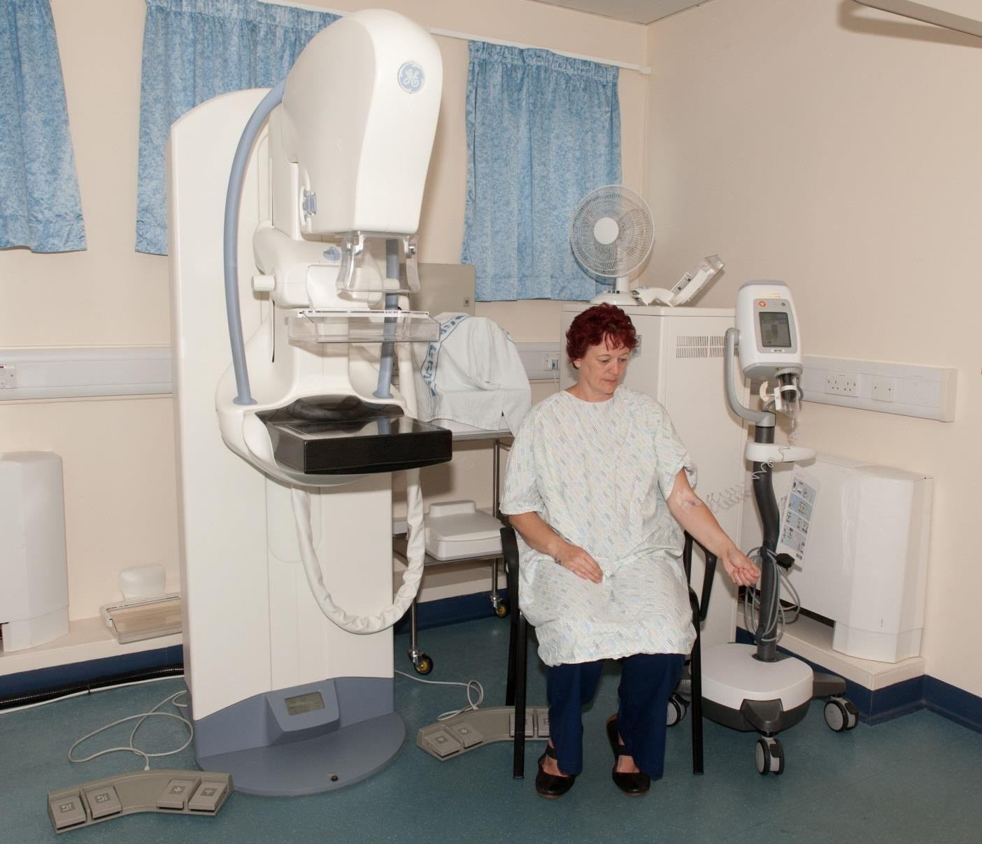

Slide 12
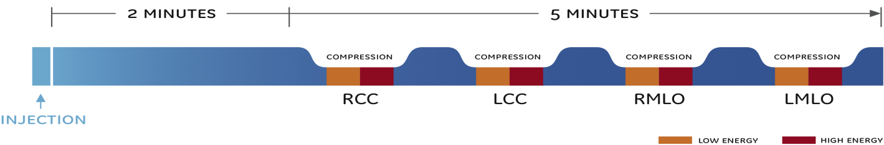
Technique
Patient consent
Allergies
Renal function
Administer 1.5.mls/kg intravenous iodine injection exactly like injected CT exams
After a 2 minute wait, perform the usual 4 mammo views in 5 minutes
Notes:
SenoBright is designed to fit easily within your practice. The procedure’s intravenous iodine injection is administered exactly the same way as in injected CT exams. After only a two-minute wait, the usual mammography protocols are then performed over a five-minute span. And its dedicated quality control protocol uses the usual FFDM phantom.

Slide 13
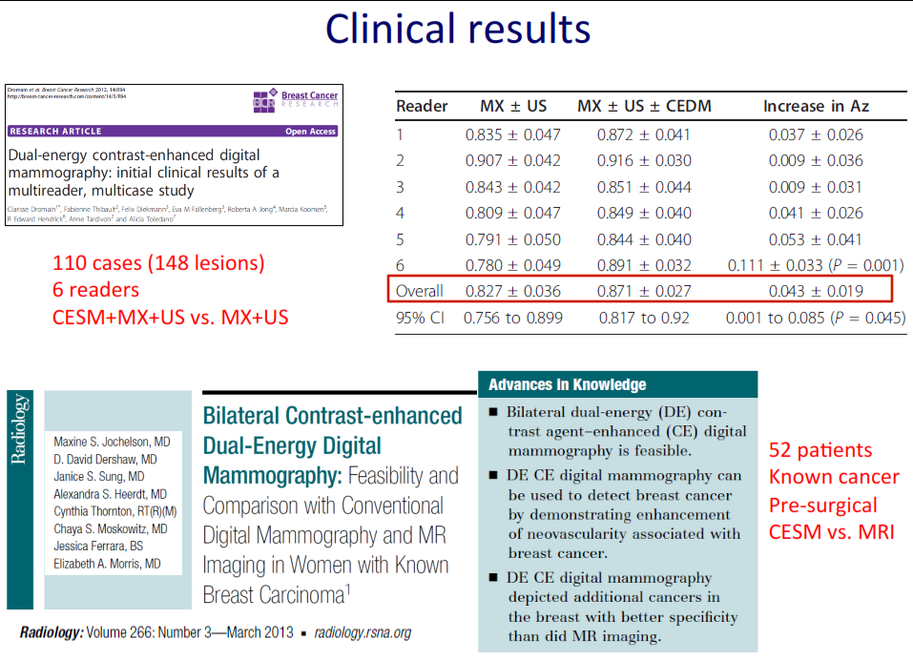

How does SenoBright fit into breast diagnosis?

Slide 14
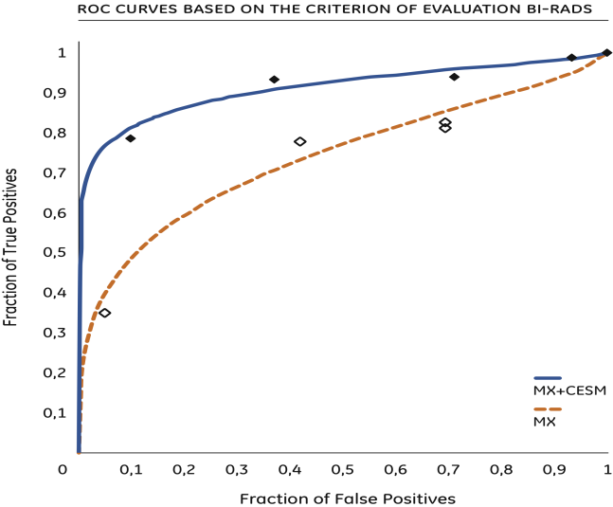
CESM.
Perform additional tests right away
same equipment, same staff, same day
Clinically proven results:
    Sensitivity: For every 100 cancers,
    potentially find 13 more
    Specificity: 6 more benign lesions out of
    100 can be correctly classified as benign.
    Negative Predictive Value: 19 more patients
    without cancer out of 100 can be sent
    home avoiding further anxiety/workup
    …versus mammography alone
Help reduce patient anxiety
DROMAIN C, BALLEYGUIER C, TARDIVON A, ADLER G, THIBAULT F, DELALOGE S
"Dual Energy Contrast-enhanced Digital Mammography: Preliminary Clinical Results"
94th Scientific Assembly & Annual Meeting of RSNA, Chicago, USA, 30 Nov. - 5 Dec. 2008.
And http://www.springerlink.com/content/d3832h243517m21p/fulltext.pdf
Notes:
SenoBright delivers more information quickly, allowing additional tests to be performed right away—on the same equipment, with the same staff, and on the same day. While a pioneering technology, SenoBright is a clinically proven technique, offering better sensitivity, specificity, and negative predictive value than mammography alone. In addition, by eliminating the delays associated with other tests, SenoBright helps reduce patient anxiety.

Slide 15
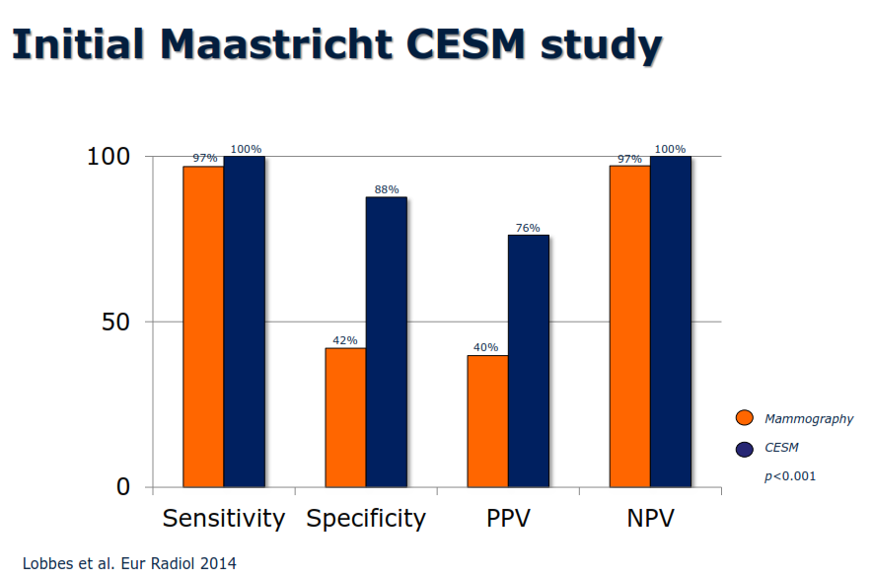
Initial Maastricht CESM Study

Slide 16
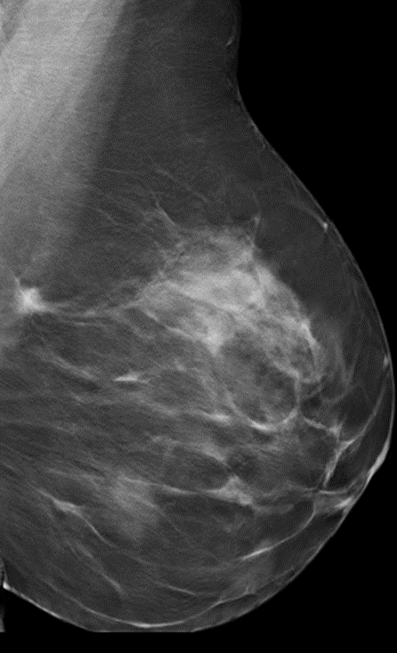
OUR CASES (1)
Mrs G.N. 42 yrs old
–annual mammogram
DM+DBT+US- spiculated mass left breast
CESM-done same day-shows enhancement

Slide 17
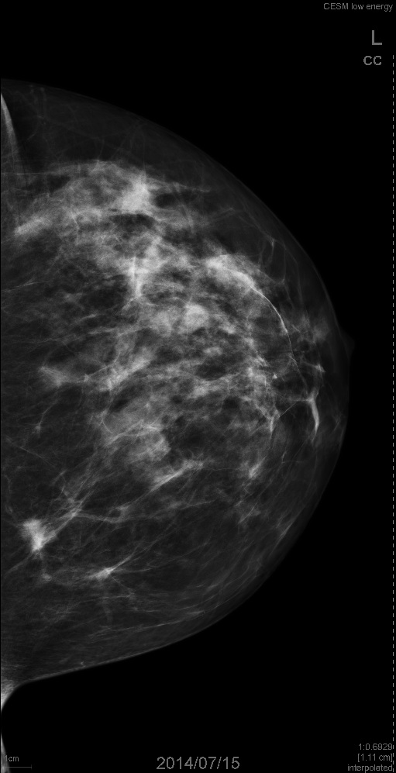
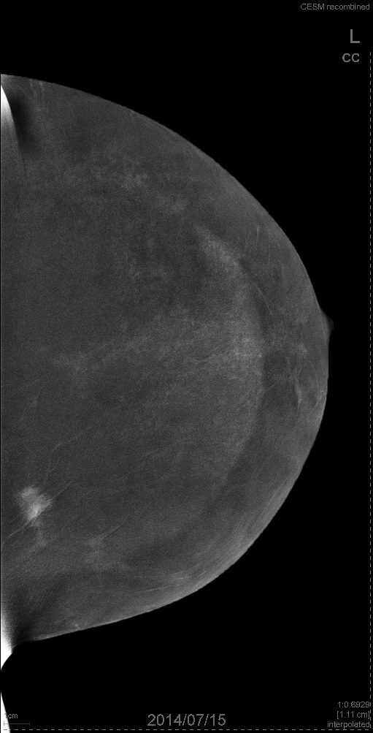
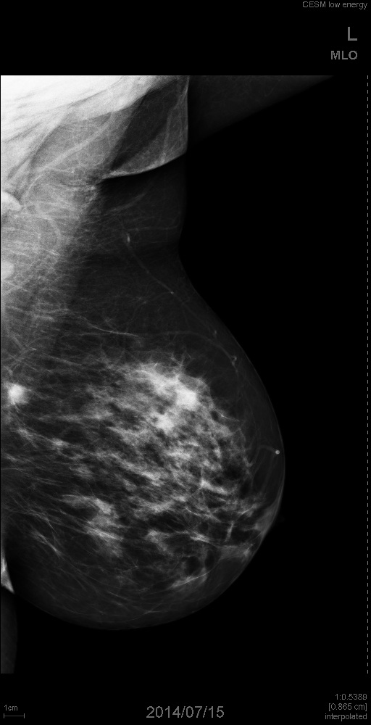
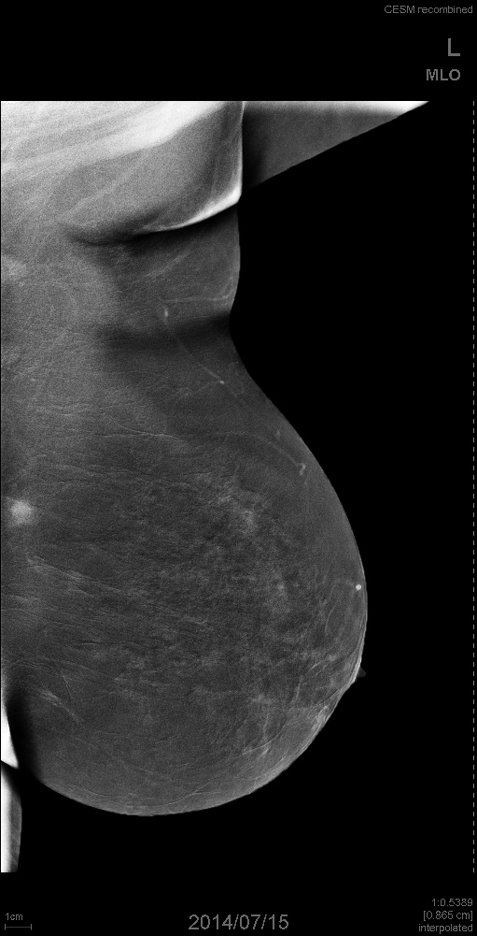
Biopsy-Grade 1 Breast duct CA

Slide 18
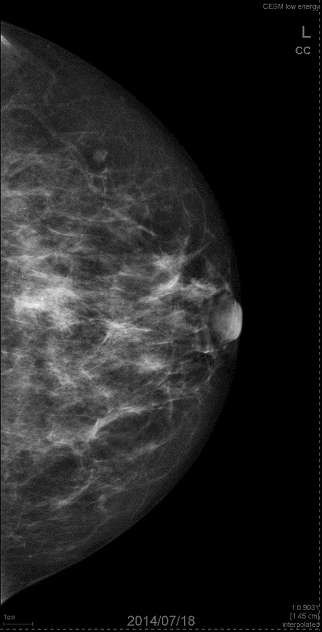
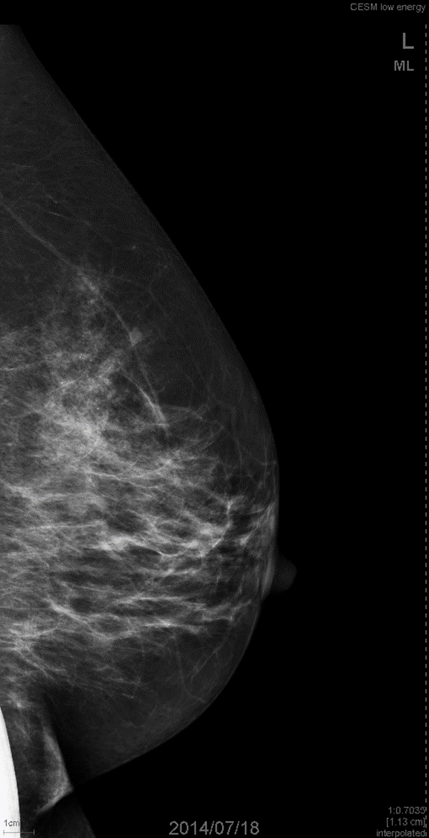
OUR CASES (2)
Mrs J.K. 56yrs
Routine Mammo-
Clustered Microcalcification
Lt Breast
CESM +

Slide 19
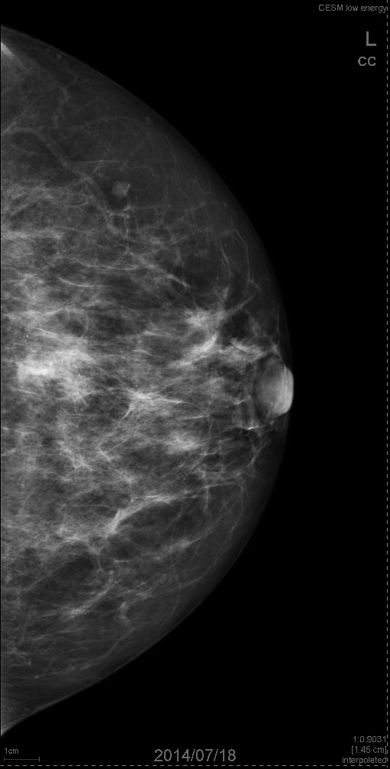
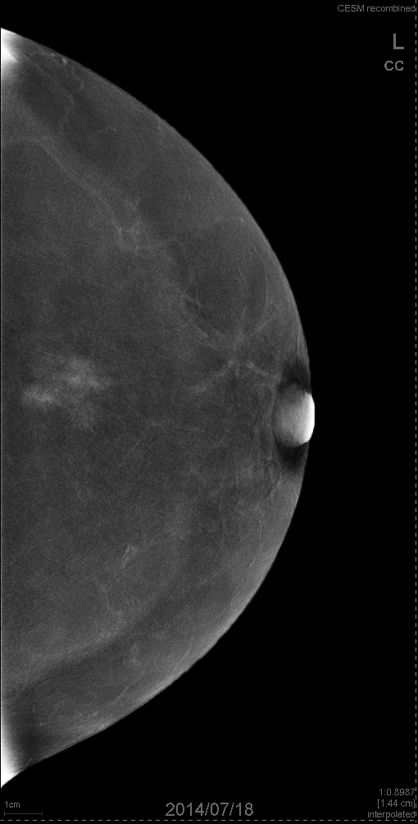

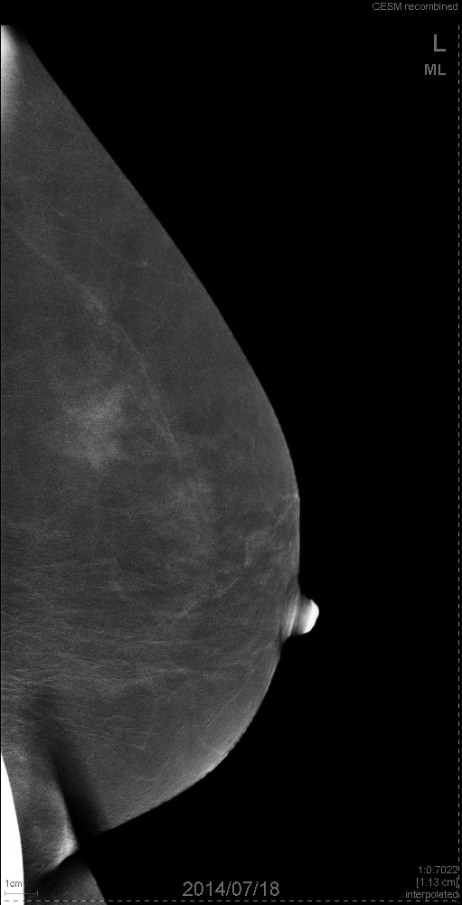
Biopsy High Grade DCIS

Slide 20
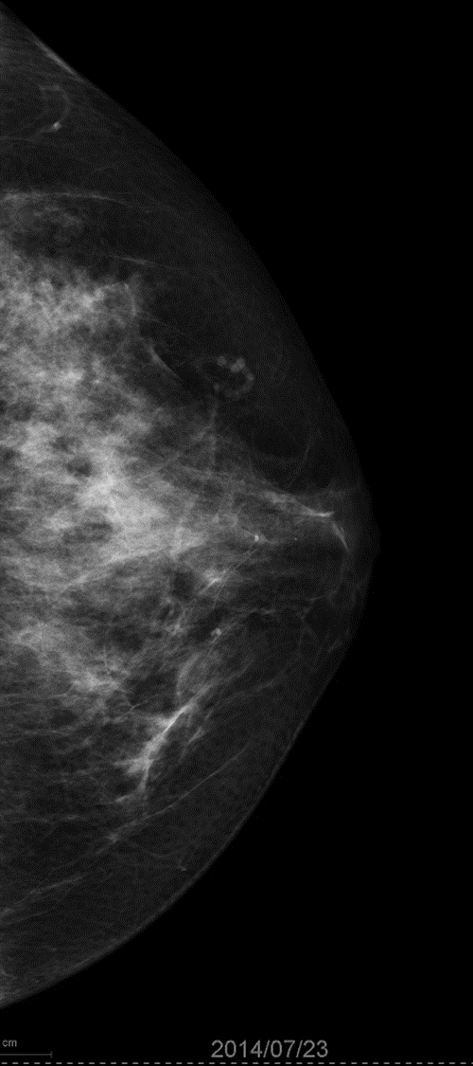
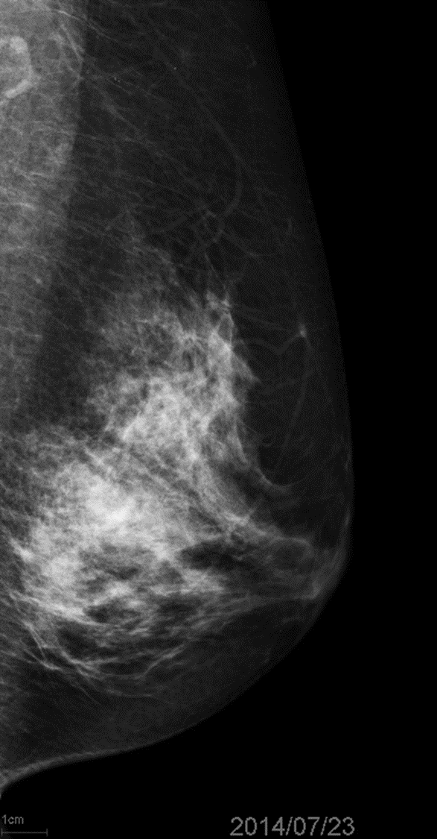
OUR CASES (3)
Mrs J.T. 52 yrs
High Risk -Anxious
Dense Breasts
Ultrasound Unhelpful
CESM

Slide 21

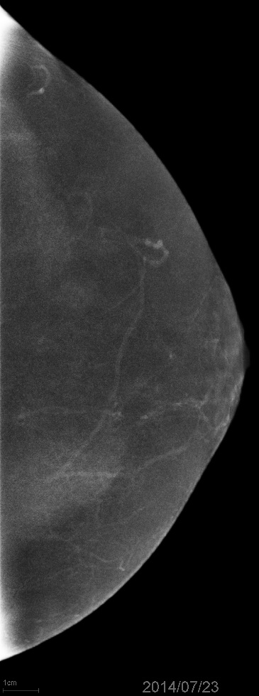

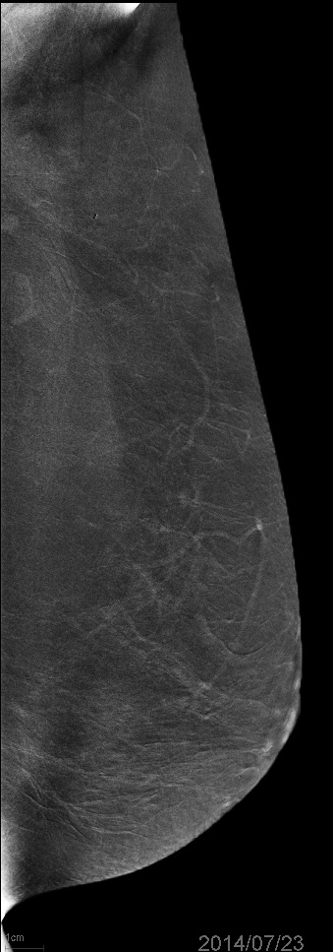

Slide 22
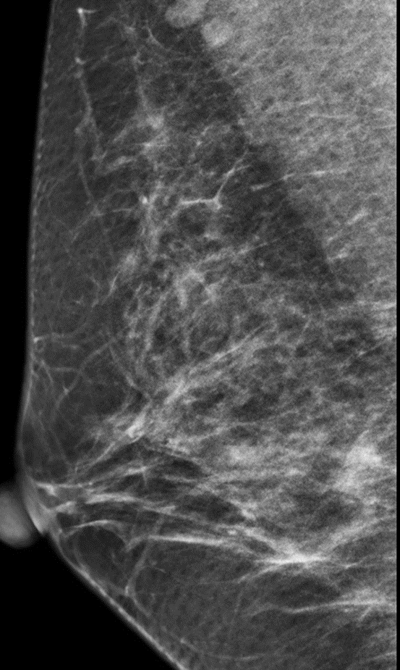
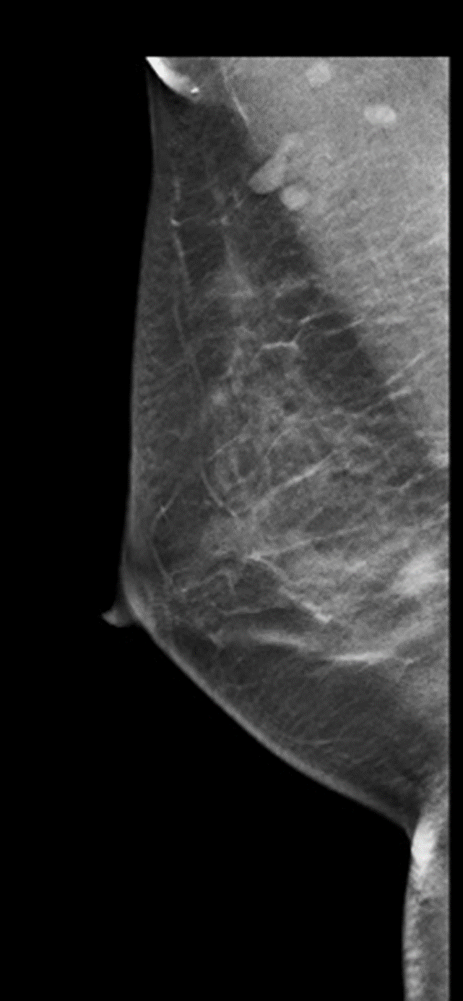
OUR CASES (4)
Mrs S.M. 41 yrs
ScreeningMammo
Asymmetric Density 1 view
High Risk
US -
DBT

Slide 23
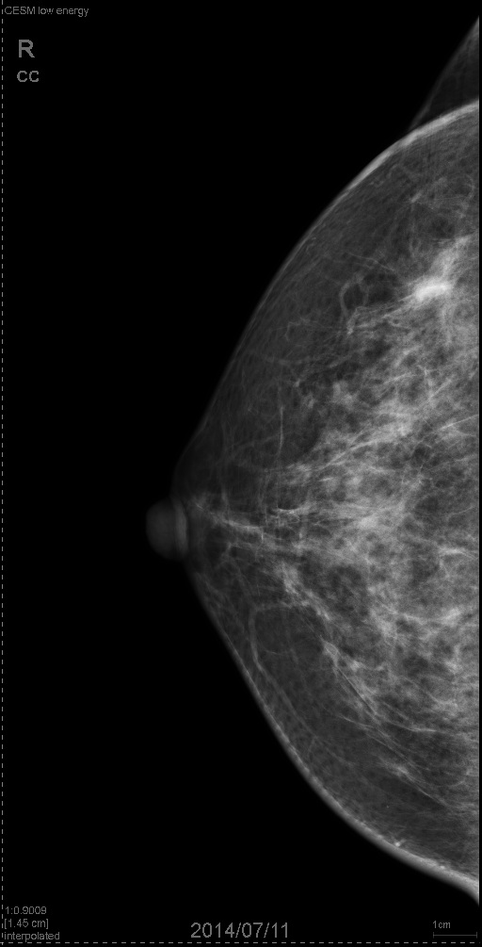
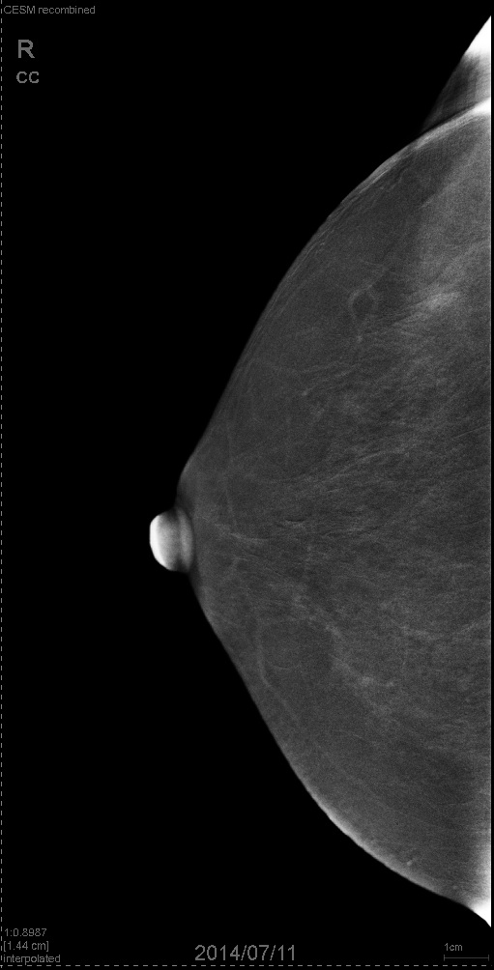
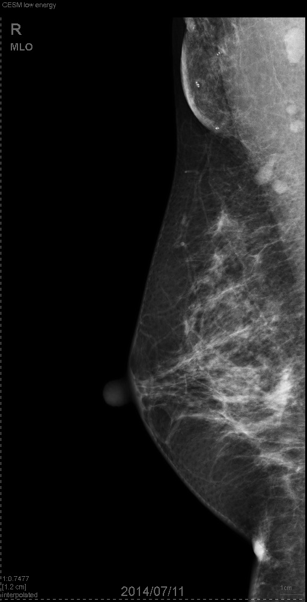
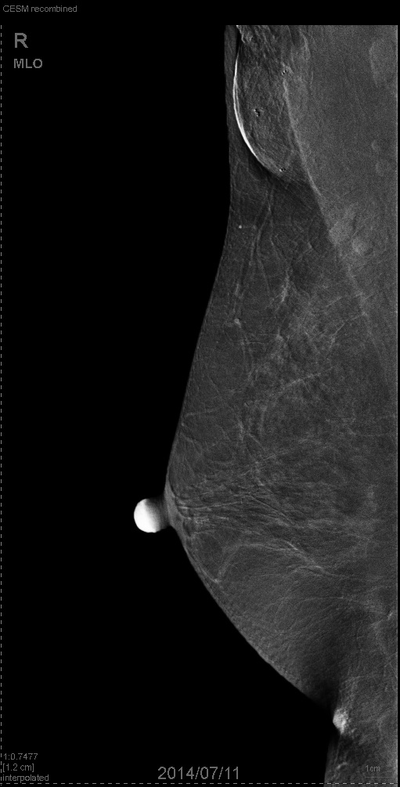

Slide 24
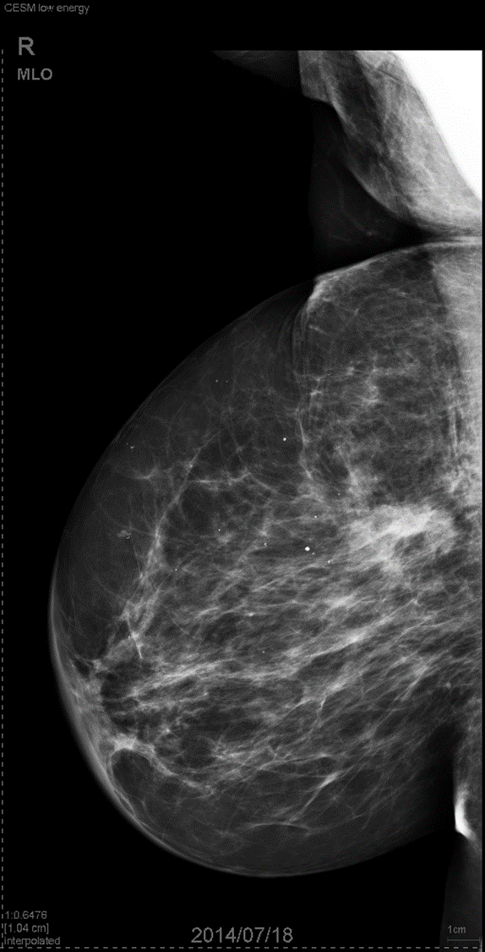
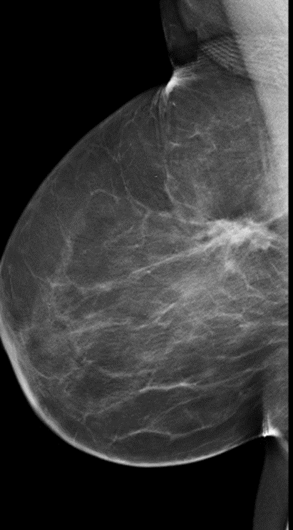
OUR CASES (5)
Mrs T.M. 64 yrs
Rt Lumpectomy
Scar Tissue
?Recurrence

Slide 25
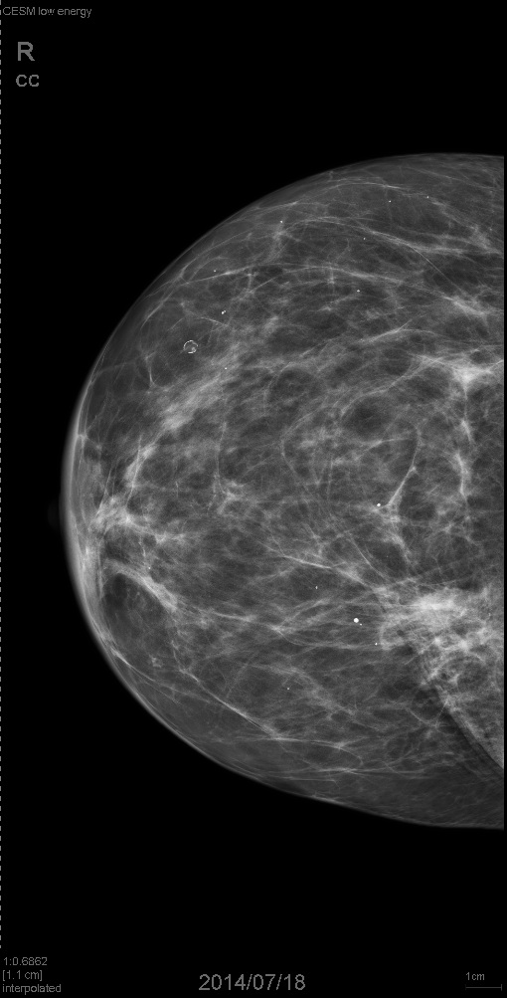
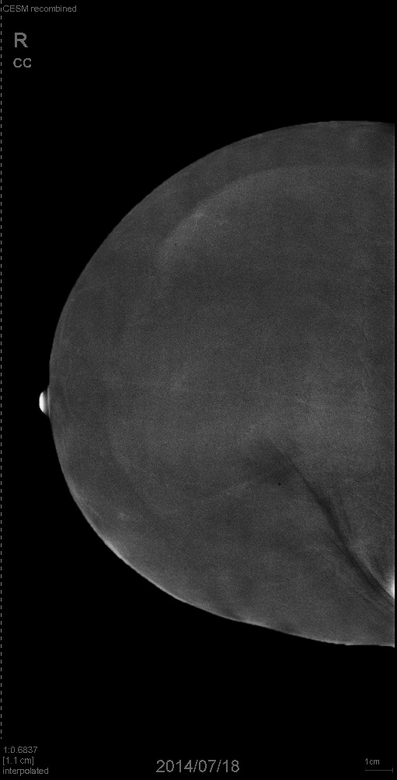
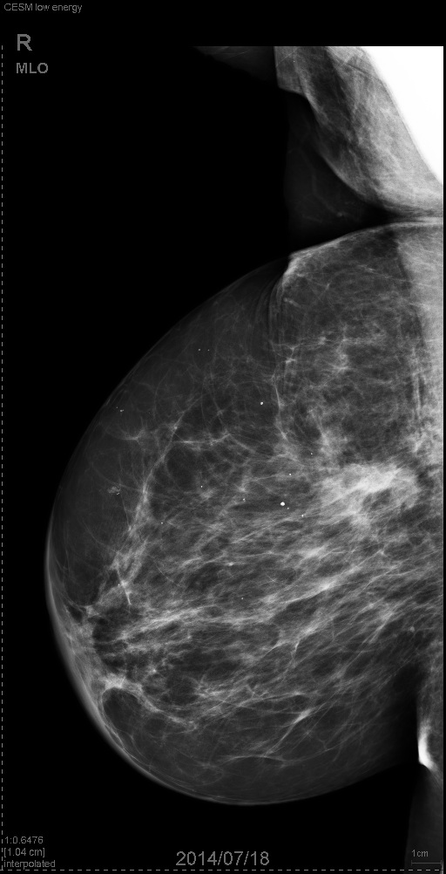
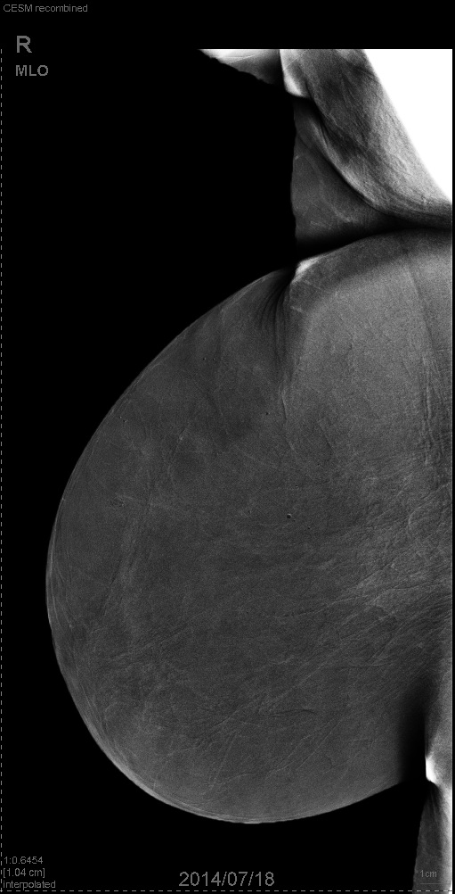

Slide 26
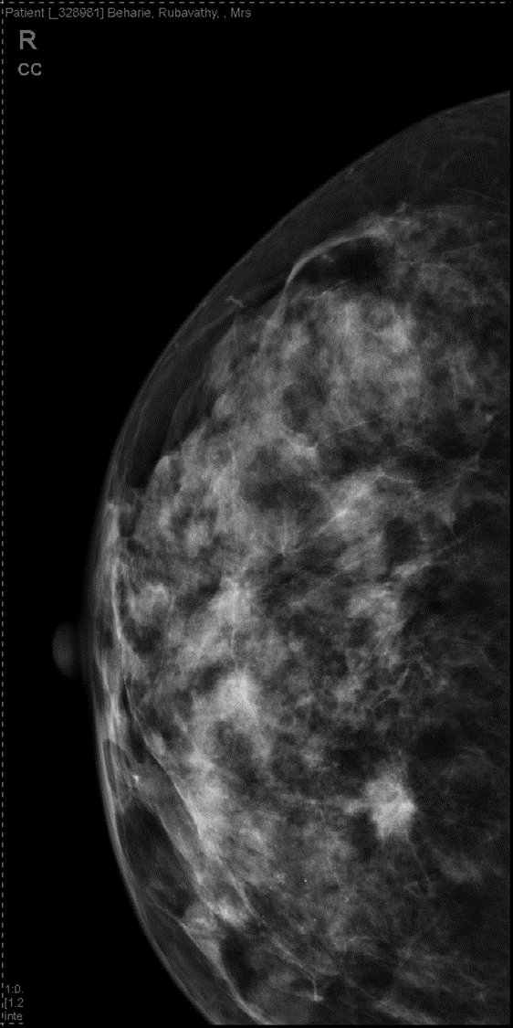
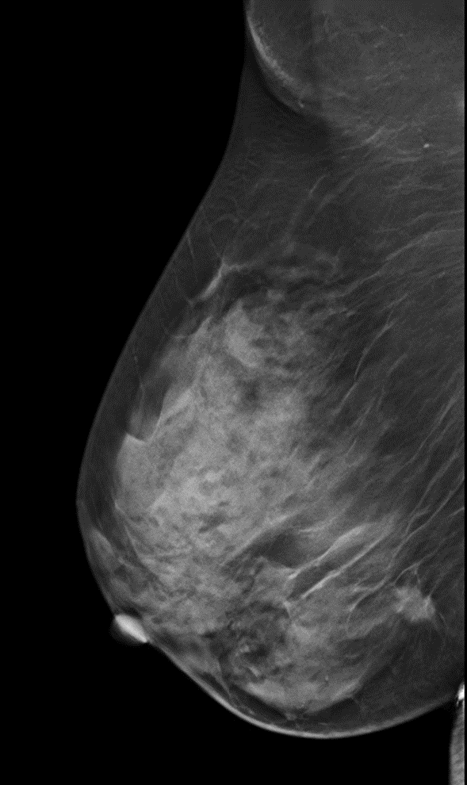
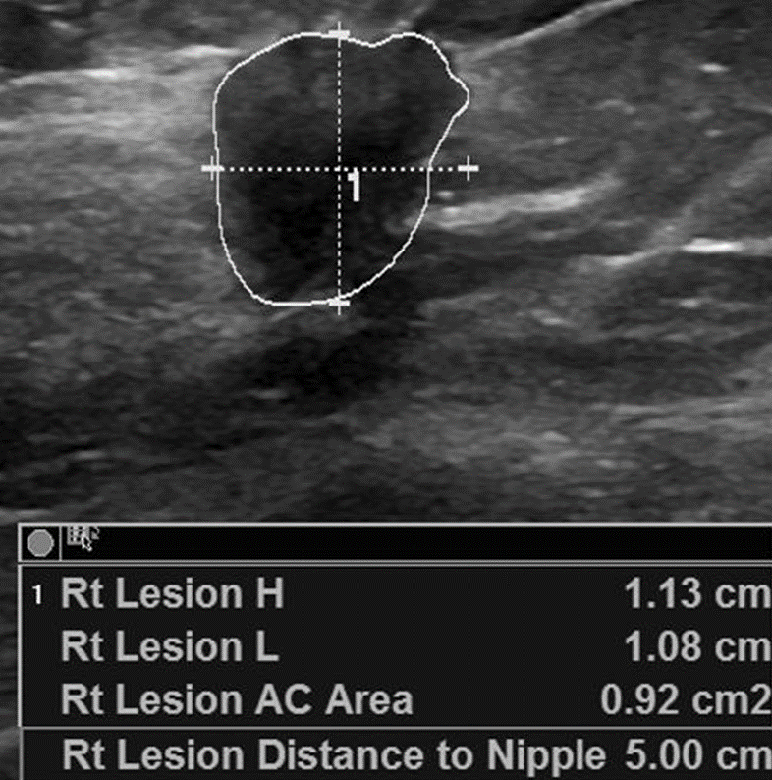
OUR CASES (6)
Mrs R.B. 59 yrs
Screening Mammo
Spiculated Mass Rt
DM+DBT+US+CESM

Slide 27
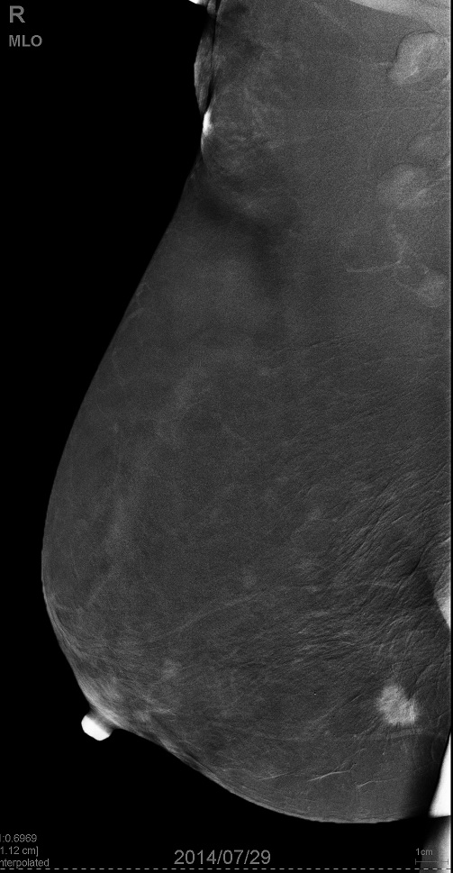
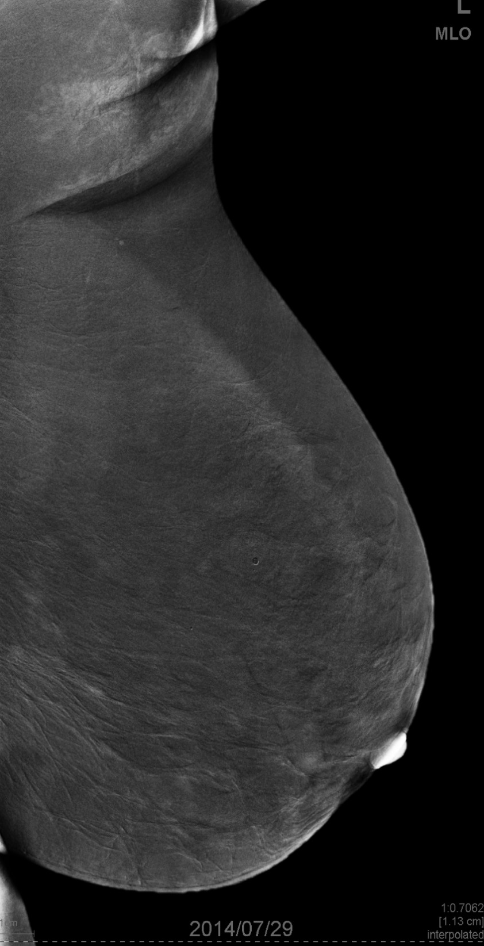
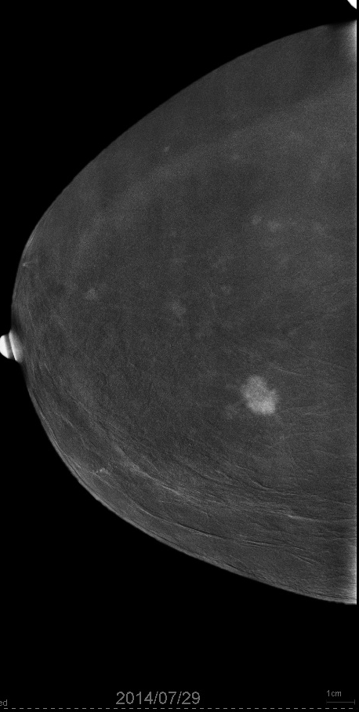
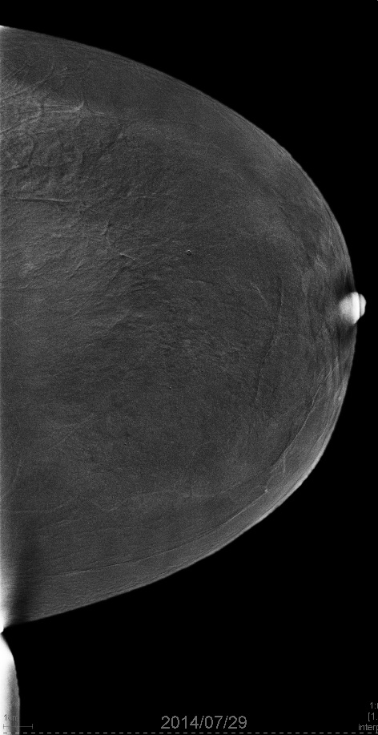

Slide 28
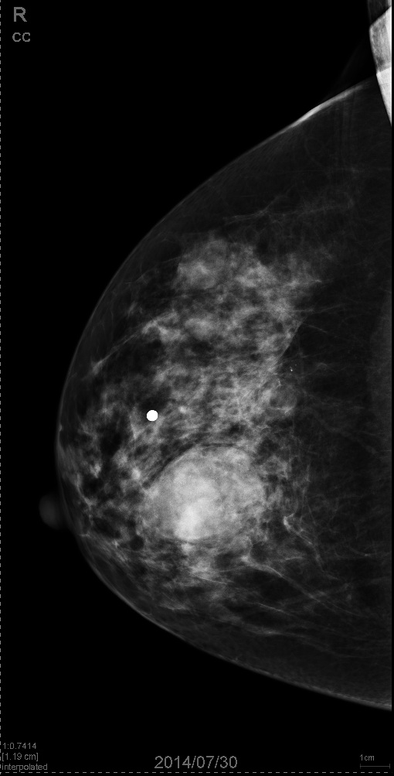
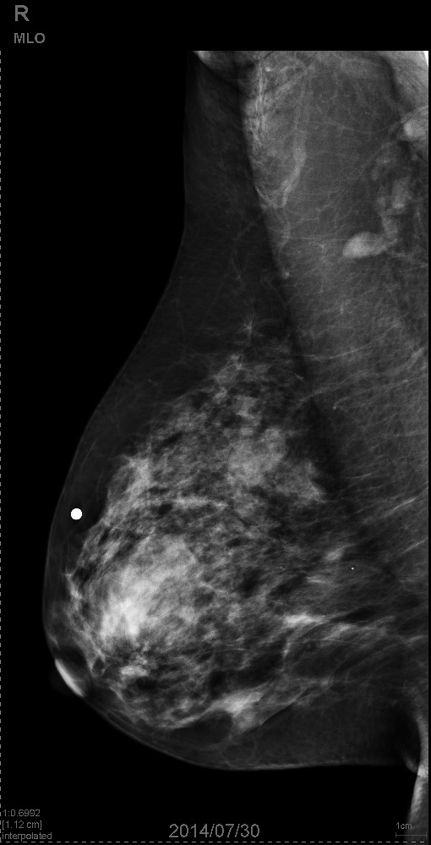

OUR CASES (7)
Dr Y.N. 51yrs
High Risk-sister died from BCA
Palpable mass Rt Breast

Slide 29





Slide 30



61 Y F
Large ill defined mass right
tether and dimpling
Le MLO Le CC

Slide 31


Recombined MLO CC
LE shows spiculated mass
CESM shows larger area 63mm

Slide 32


Baseline MRI
CEMRI Axial Reformat Sag
The total size of abnormality at MRI is 55mm

Slide 33

Case 6 -Right recombined MLO vs
Sagittal CEMRI Reformat

Slide 34

False positive - fibroadenoma

Slide 35

Potential indications for CESM
Evaluation of disease extent

Slide 36

Potential indications for CESM
Inconclusive findings

Slide 37

Potential indications for CESM
Neoadjuvant chemotherapy response monitoring

Slide 38

Potential indications for CESM
Evaluation of the post-surgical breast

Slide 39


Potential indications for CESM : Breast MRI alternative

Slide 40


Slide 41
Where Does CESM Fit In ?
Patients who have Asymmetry or Architectural distortion , a negative CESM allows us to place into short term follow up.
Patients who have multiple masses on US, CESM helps in determining the dominant mass to biopsy or a negative CESM allows us to place into short term follow up.
Patients who have calcifications, CESM helps determine which patients to biopsy and who to subject to short term follow up.
In a patient with known breast malignancy- can find additional lesions.
Results are immediate

Slide 42
PROS
Quick to perfom
Results available immediately
Easy to report
Improves confidence
As good as MRI for lesion size
Relatively cheap

Slide 43
Cons
Issues with contrast
Increased examination time
May not see as far back as MRI
No reimbursement

Slide 44
TAKE HOME
A preliminary study in a large scale breast cancer screening program confirms the
good diagnostic accuracy of CESM for breast cancer detection.
Compared with mammography alone, CESM increases the sensitivity without a loss in specificity.
Thanks to high specificity, CESM has the potential to improve the cancer detection rate, the staging and the selection of patients for biopsy.
CESM could also be of particular interest for the assessment of the extent of breast
cancer, for dense mammograms, for the detection of contralateral and/or multifocal breast cancers, and for contra-indications of MR.
This technique should be considered a complementary tool to conventional digital MG
Contrast-enhanced spectral mammography (CESM)large scale breast cancer screening program. Congress: ECR 2012
A. Loshkajian; H. Sahmi; F. D'Antouard; C. Balleyguier; Dromain; Creil Velizy

Slide 45


THANK YOU
Health is like money, we never have a true idea of its value until we lose it.
Josh Billings
Book mammo

