Slide 1
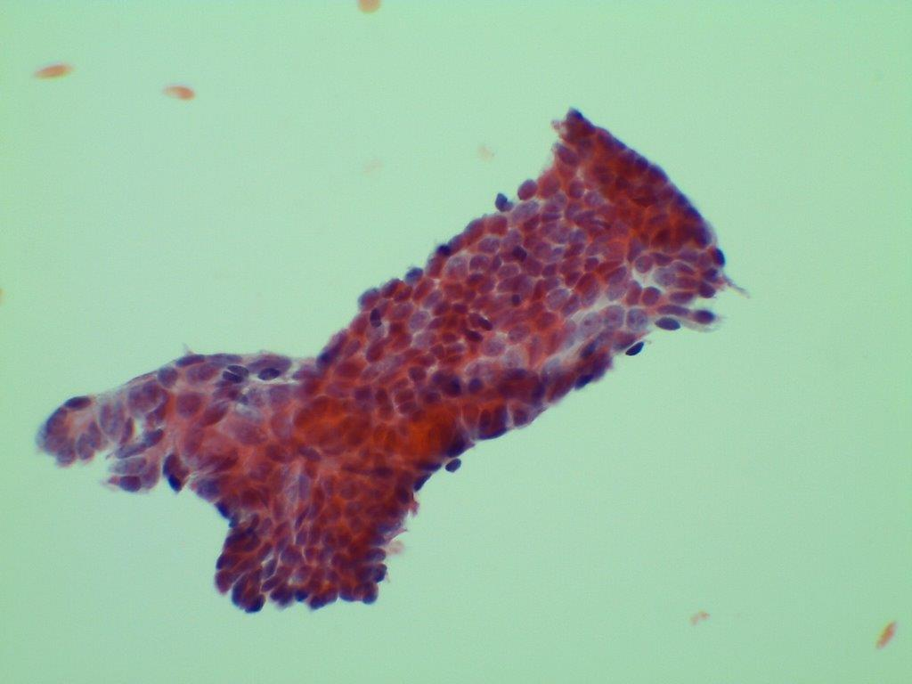

Slide 2
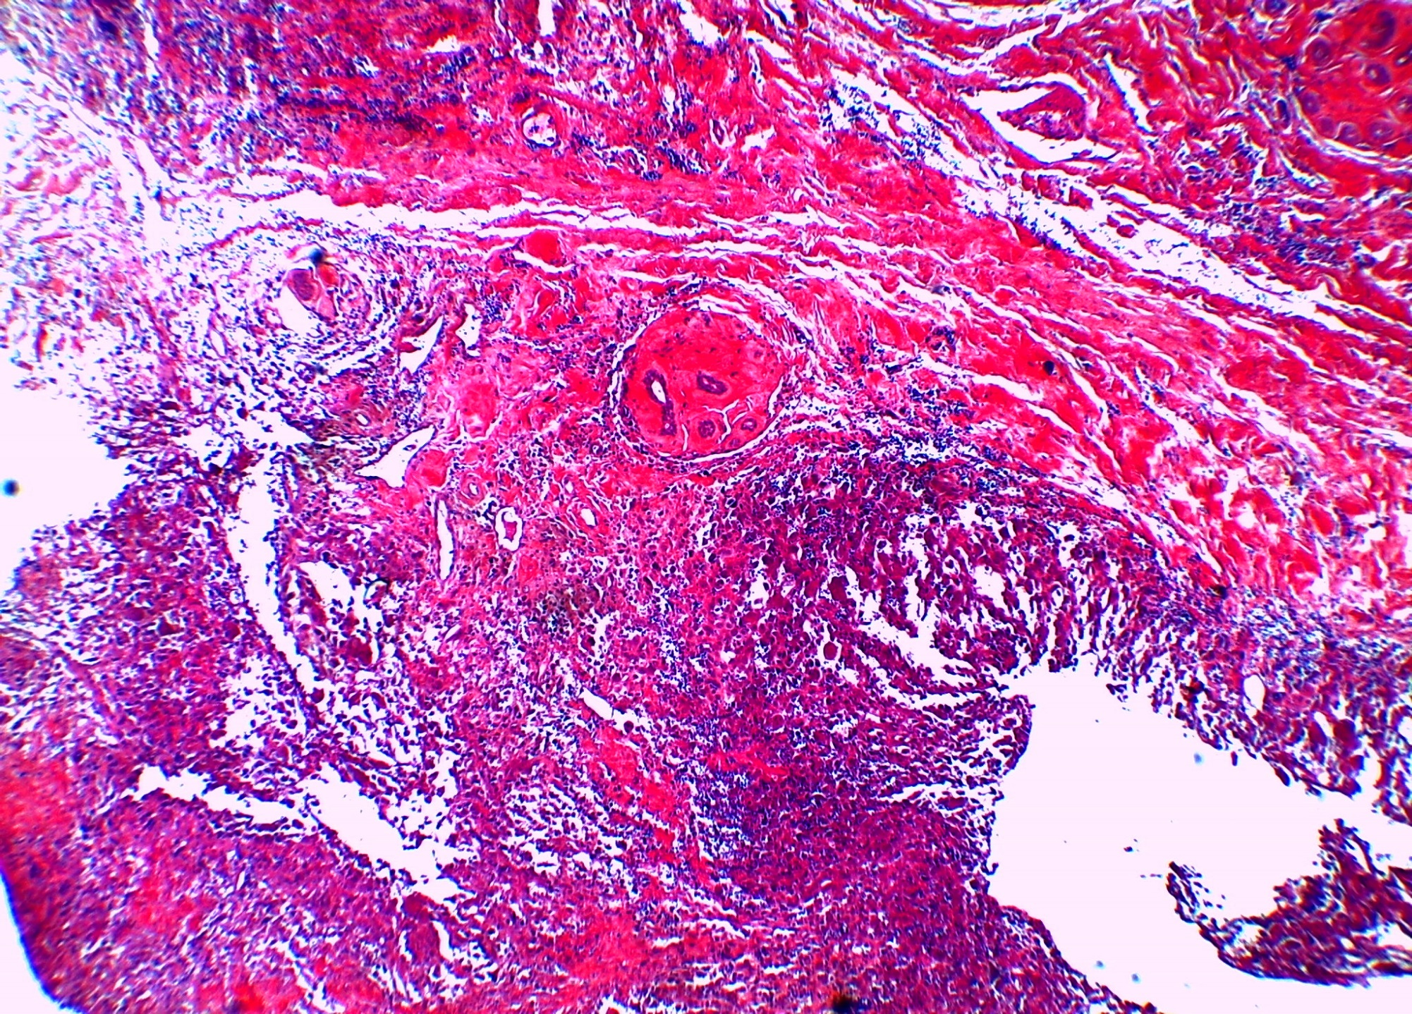

Slide 3
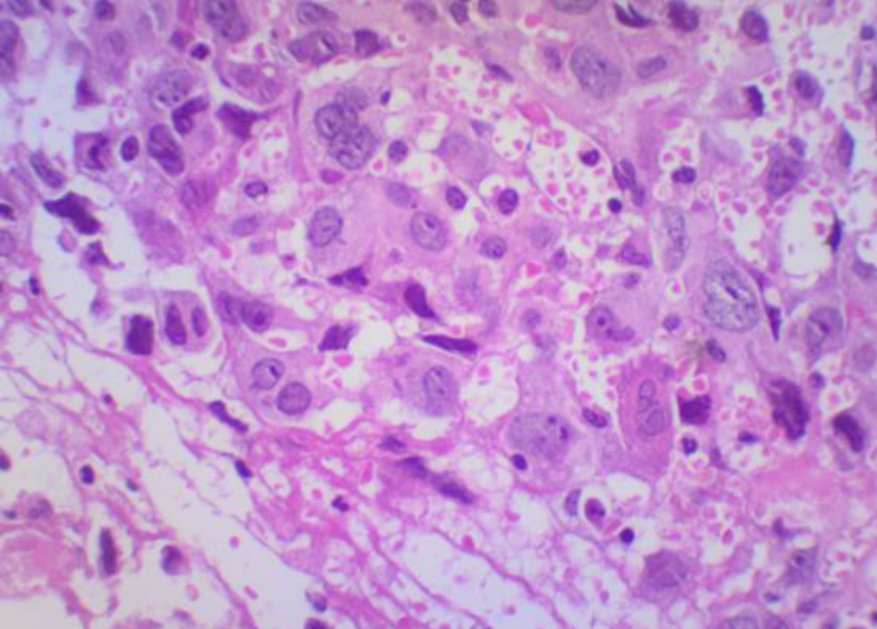

Slide 4
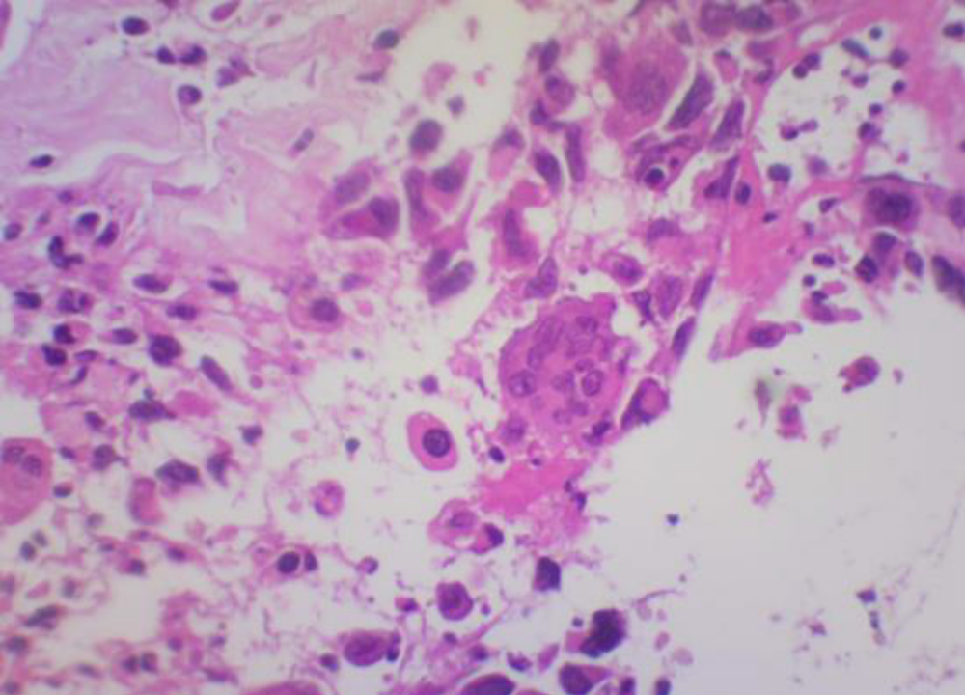

Slide 5
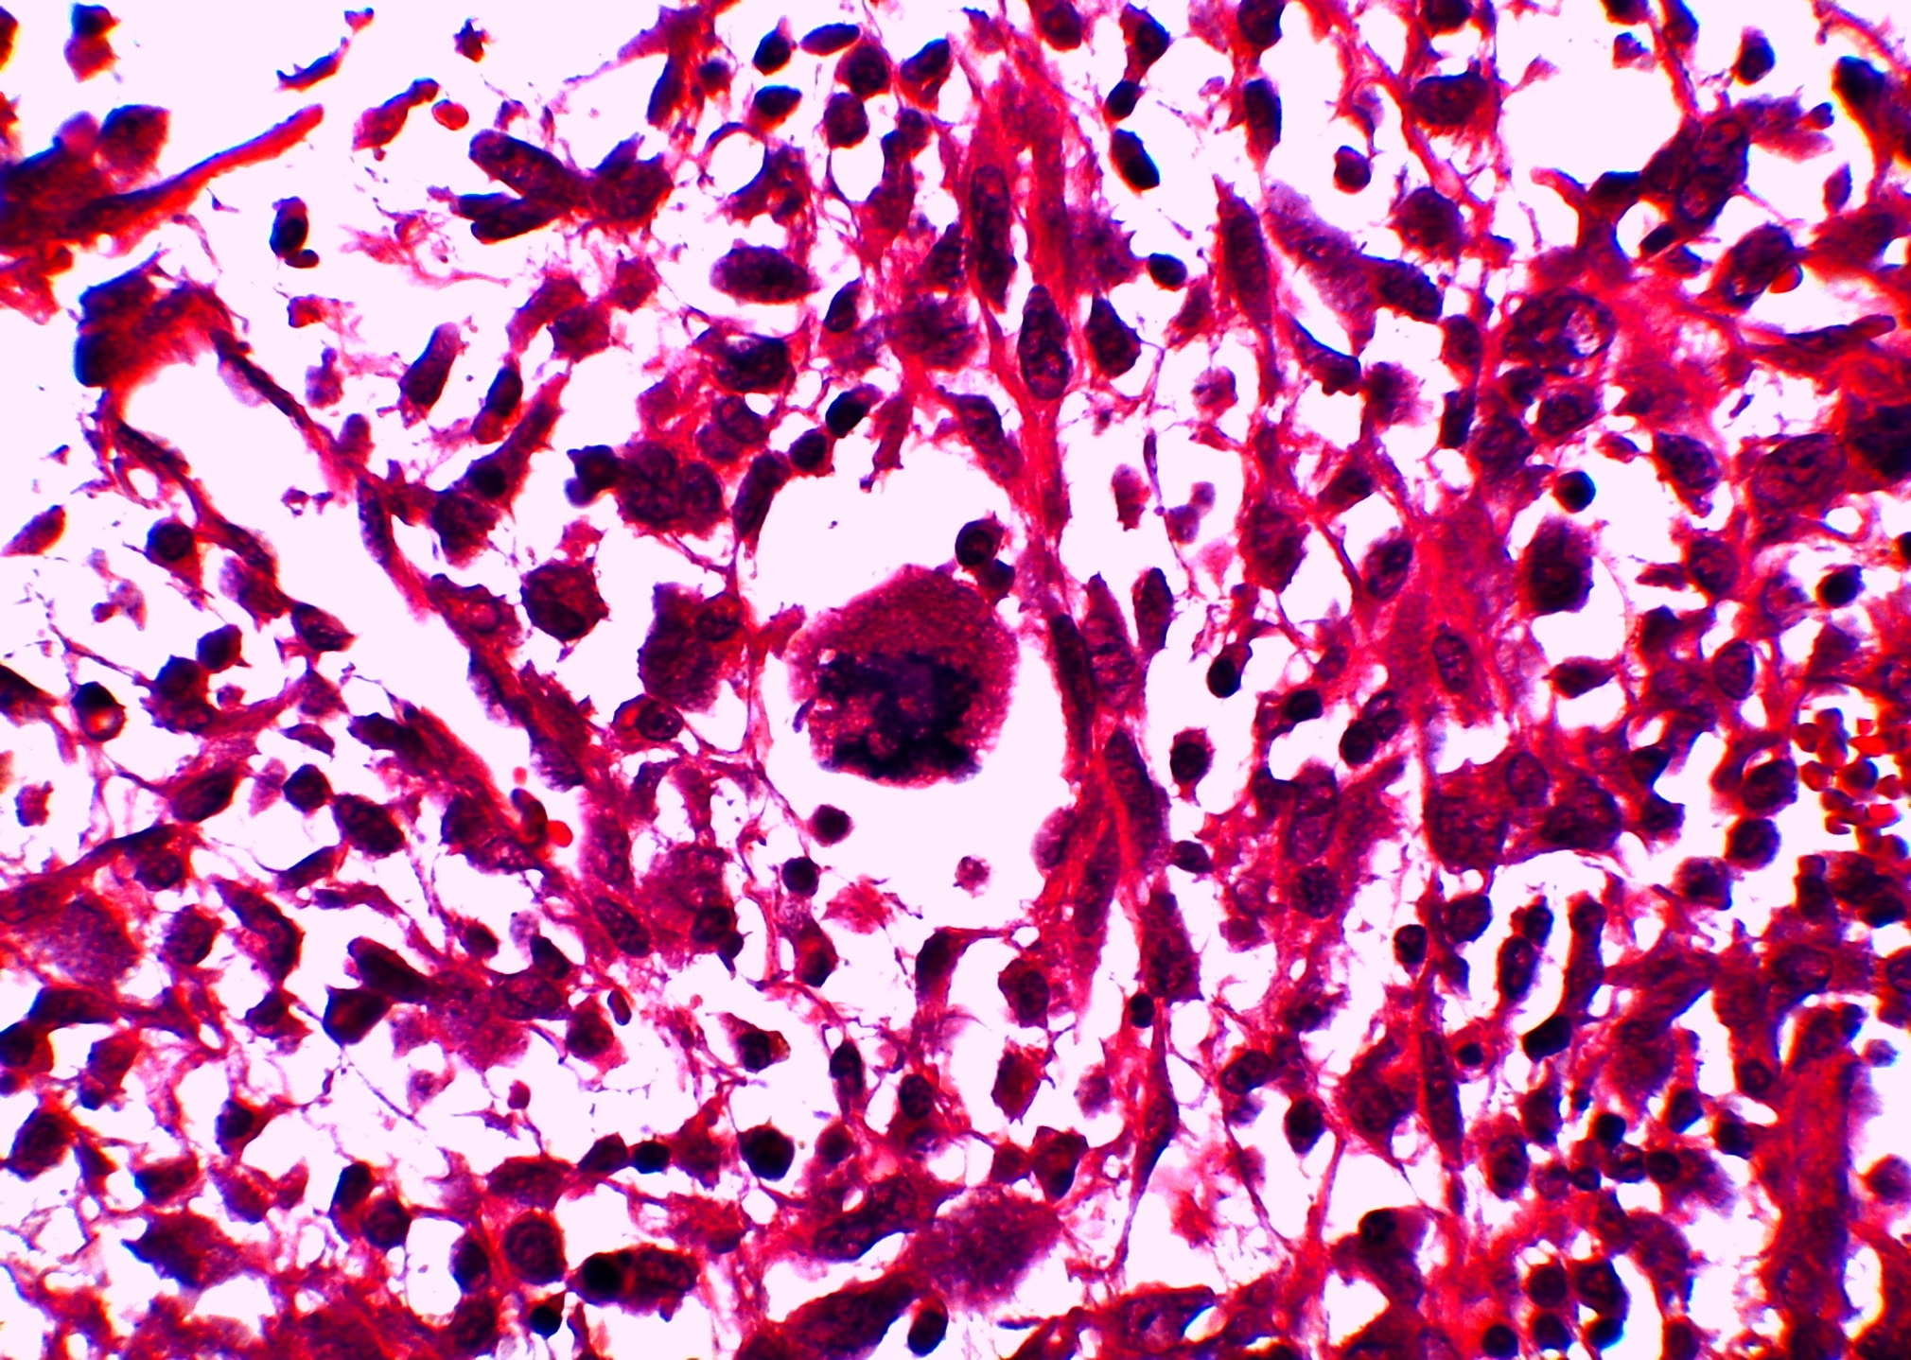

Slide 6
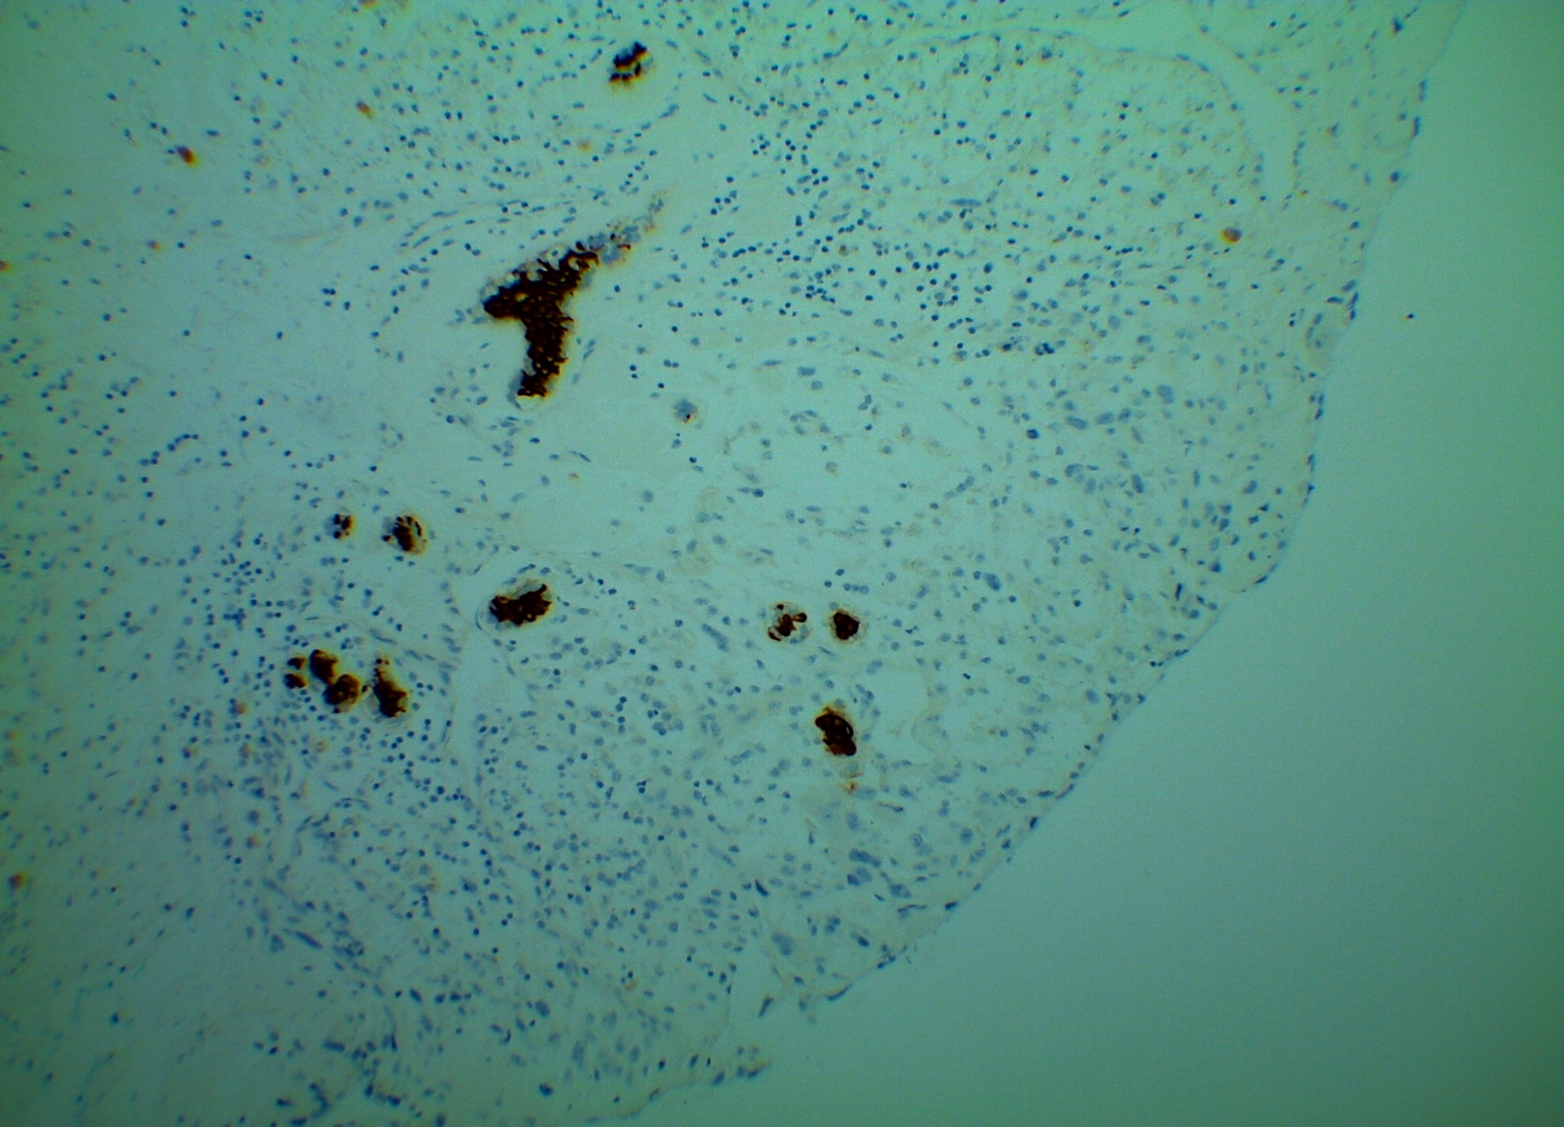

Slide 7
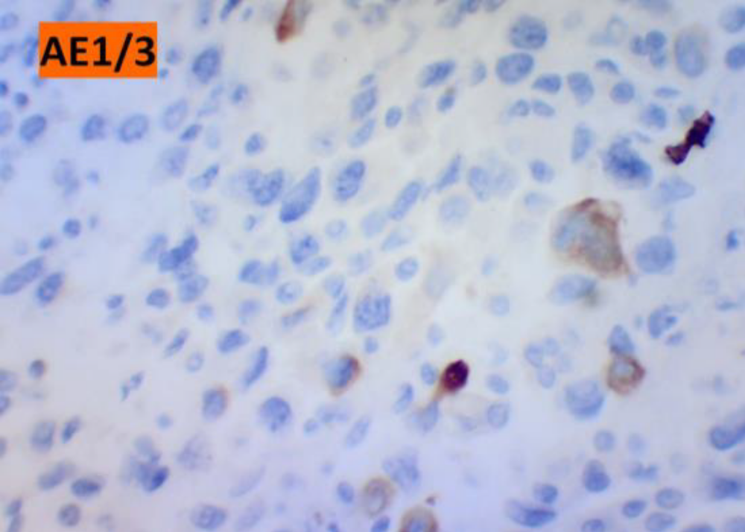

Slide 8
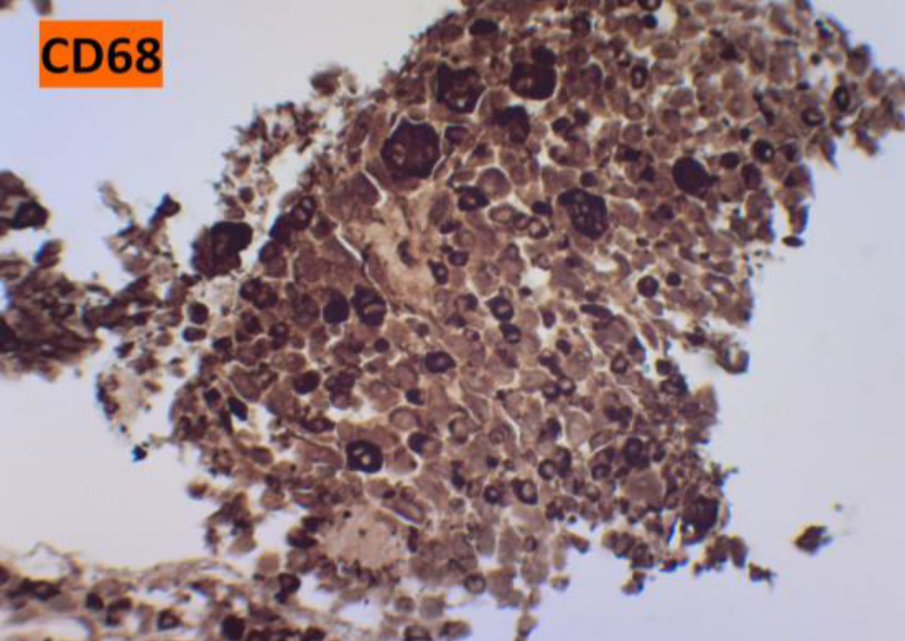

Slide 9
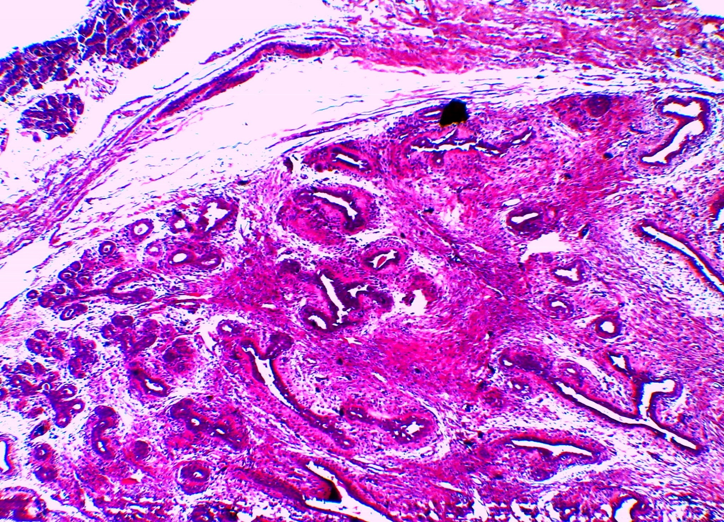

Slide 10
IMMUNOHISTOCHEMISTRY
NEGATIVE
Estrogen Receptor
Progesterone Receptor
Desmin
S100
E-cadherin
Actin
EMA
CD31
CD34
CD3
CD20
CD30
ONLY ISOLATED CELLS POSITIVE
AE1/3
MNF 116
CD 68 (giant cells)

