Slide 1
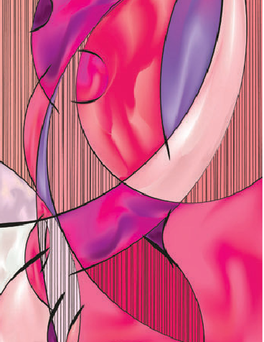
CASE OF THE QUARTER
Malignant transformation of fibroadenoma
Dr H. I. Rajput
Parklands Hospital
Durban
Feb 2016

Slide 2
Patient- Ms. T. N.
23 years of age, Indian Female
2011- right breast lump (3/12)
Painless and Mobile
No F/H
No medical history
U/S – 1.7cm x 3.0cm x 2.7cm
Hypoechoic Lesion
CASE OF THE QUARTER

Slide 3
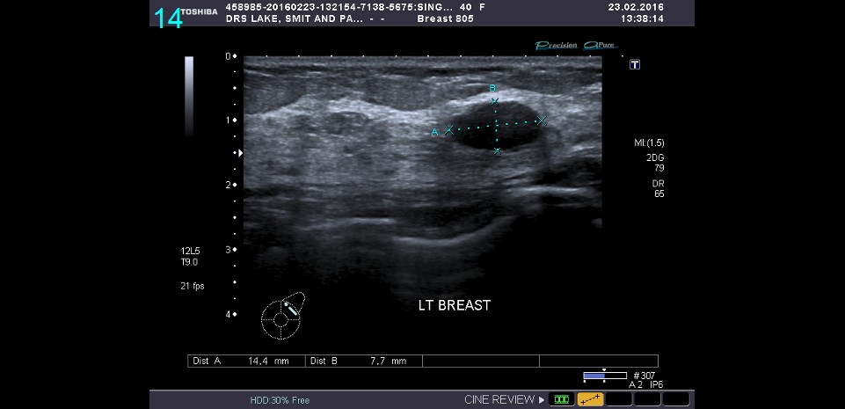
Ultrasound Breast
(R) Breast
1.7cm x 3.0cm x 2.7cm
CASE OF THE QUARTER

Slide 4
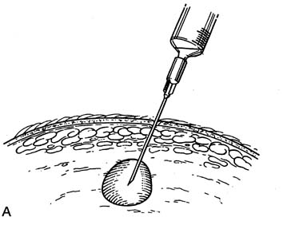
FNAC
Benign with Myoepithelial Cells in keeping with fibroadenoma
Patient was reassured
CASE OF THE QUARTER

Slide 5

Nov 2015
Large right breast lump
Painful
Increasing in size
No nipple discharge
Clinically solid with
cystic component
(5cm diameter)
No Axillary nodes
palpable
(R) Breast
CASE OF THE QUARTER

Slide 6
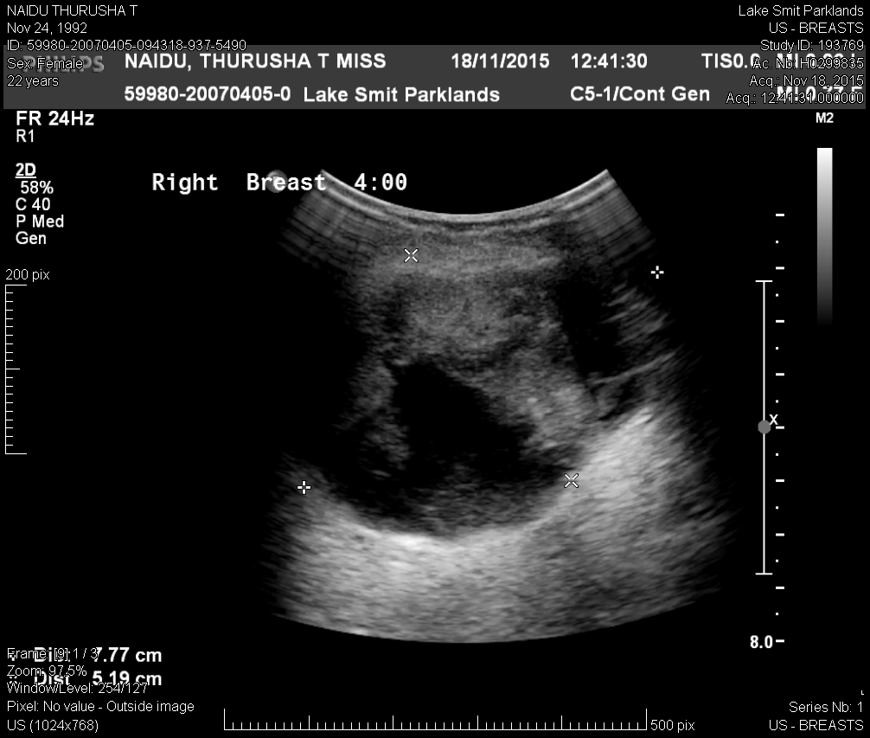
Ultrasound Breast
CASE OF THE QUARTER

Slide 7
FNAC
No atypical or malignant cells noted
Excision Biopsy
CASE OF THE QUARTER

Slide 8
EXCISION (R) BREAST LUMP (30/11/2015)
Histology
Fibrous stroma, cyst lined with malignant cells.
Features of sarcoma, most likely malignant
phylloides tumour
CASE OF THE QUARTER

Slide 9
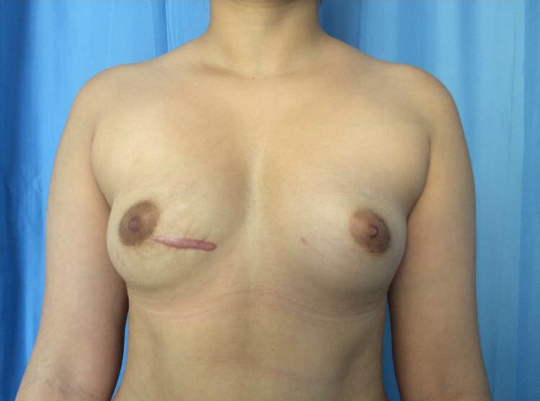
CASE OF THE QUARTER

Slide 10
Staging Investigations
MRI breast (Post Excision) - architectural distortion in keeping with recent surgery
Chest X-ray – No Mets.
U/S abdomen + Pelvis – No Mets.
CASE OF THE QUARTER

Slide 11
DEFINITIVE SURGERY
(R) Skin Sparing/Nipple Sparing Mastectomy and Axillary Lymph Node Dissection
Immediate reconstruction with anatomical silicone implant.
(18/01/2016)
CASE OF THE QUARTER

Slide 12

HISTOLOGY – MASTECTOMY AND AXILLARY LYMPH NODE DISSECTION
No Residual Tumour
9 Lymph Nodes (No Metastases)
CASE OF THE QUARTER

Slide 13
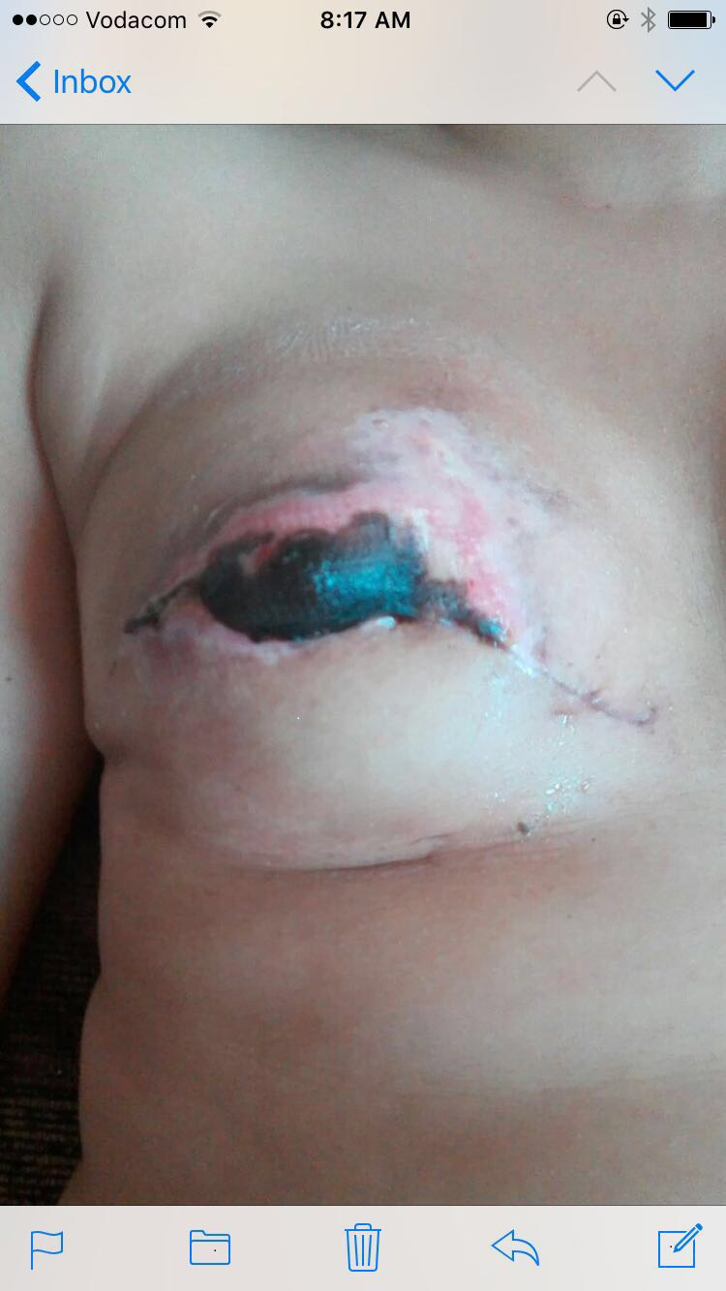
Two weeks post op
CASE OF THE QUARTER

Slide 14
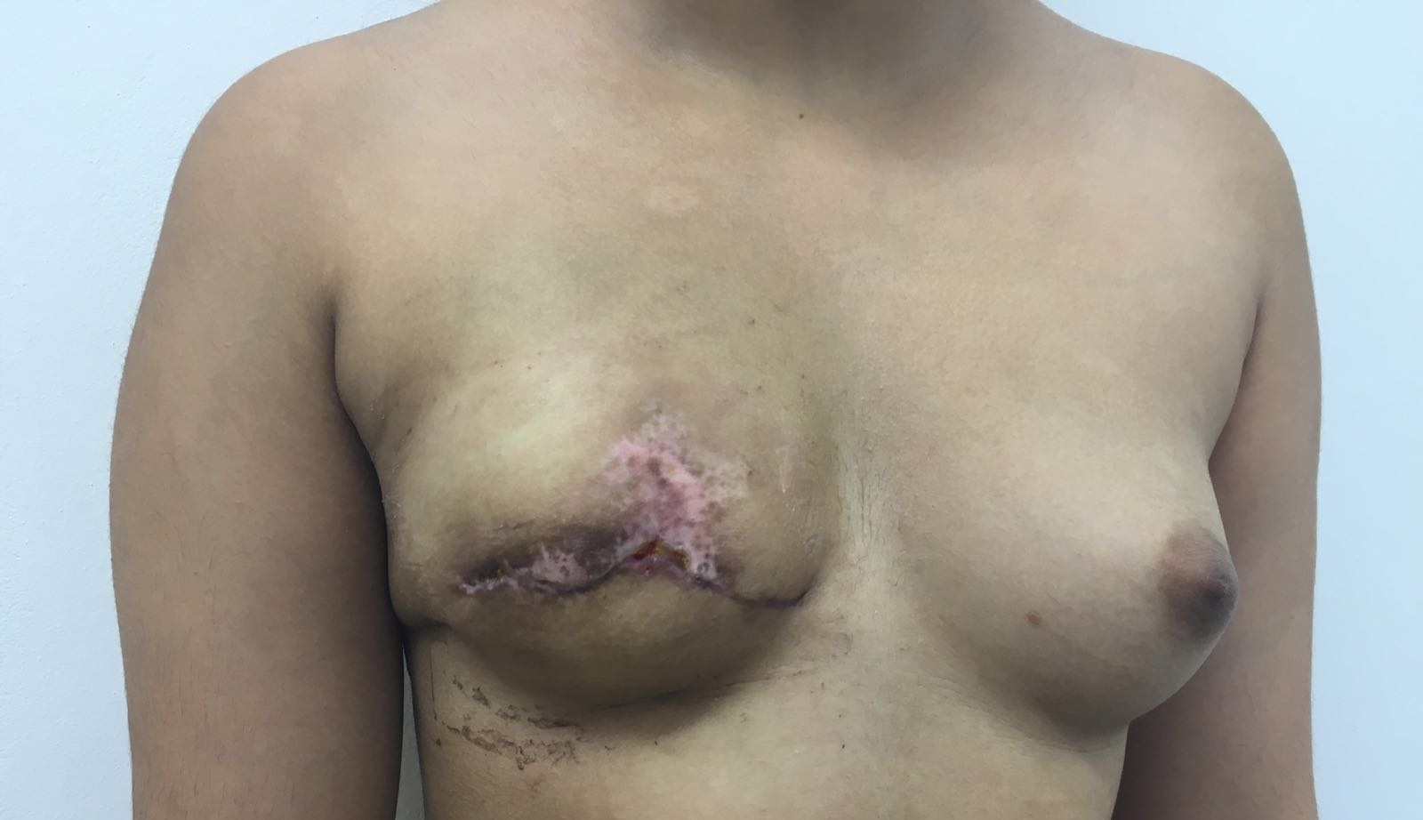
Four weeks post op
CASE OF THE QUARTER

Slide 15
ONCOLOGICAL MANAGEMENT
No Chemotherapy / Radiotherapy
Close follow up
CASE OF THE QUARTER

