Slide 1

FUTURE MEETINGS
BIGOSA meeting 10th October… www.bigosa.co.za
NEXT DBCF date 17th November… www.durbanbcf.com

Slide 2
Ki67
Presented by:
Dr Ashwin Bramdev

Slide 3
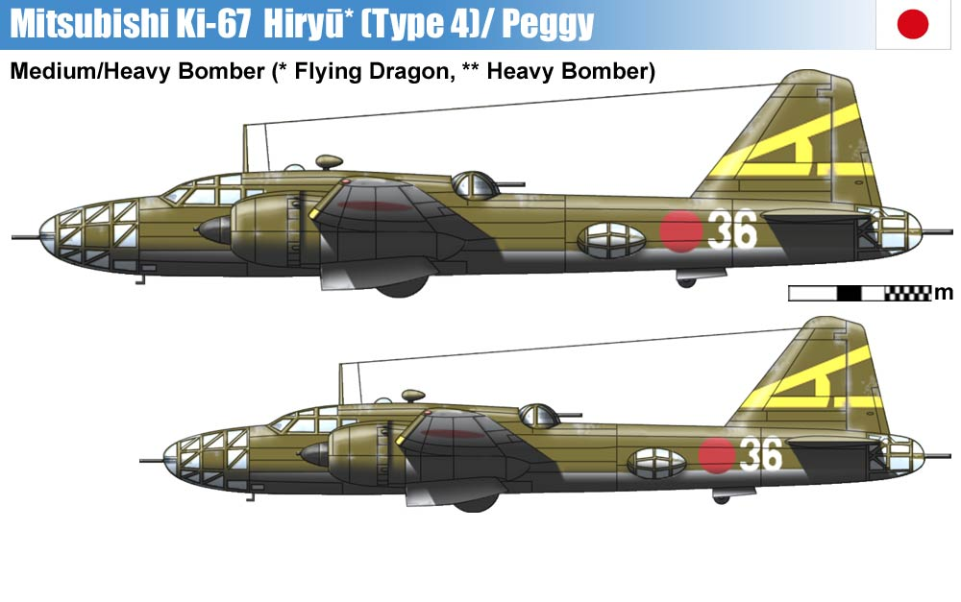

Slide 4
INTRODUCTION
Nuclear protein associated with cellular proliferation
Originally identified in early 1980’s at University of Kiel in Germany
IHC is most prevalent analysis method
Expressed in S,GI,G2 and M phases of the cell
Non existent in GO phase
Normal breast < 3% of ER negative cells, and not in ER positive cells.

Slide 5
Mitotic index, most established form of proliferation assessment, however number per area unit is not linearly related to rate of proliferation
Cell cycle biomarkers, eg. cyclin D1, cyclin E and p21 often used as prognostic factors. Net result of cell cycling is proliferation, therefore IHC analysis of Ki67 using MIB-1 antibody is marker of choice.

Slide 6
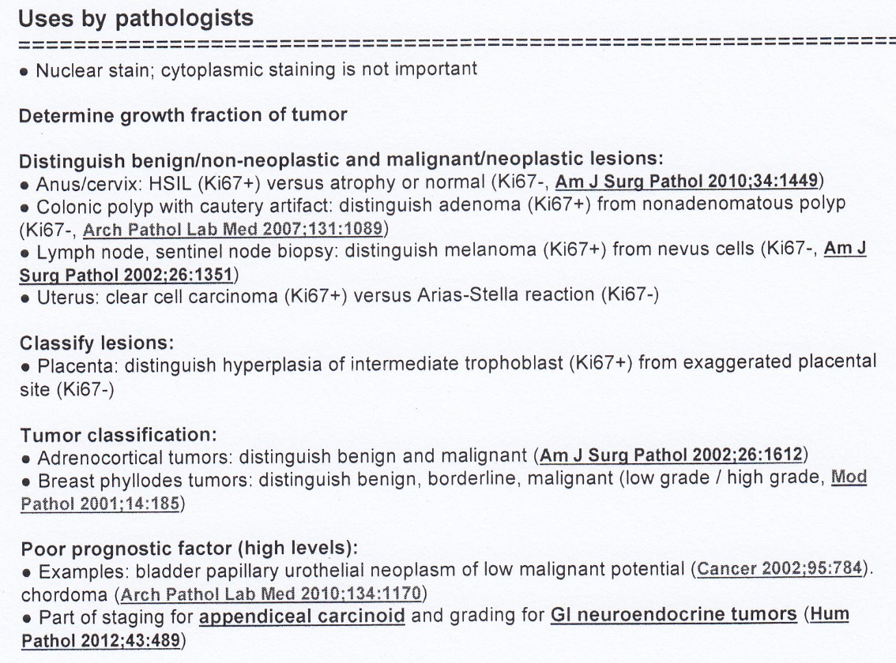

Slide 7
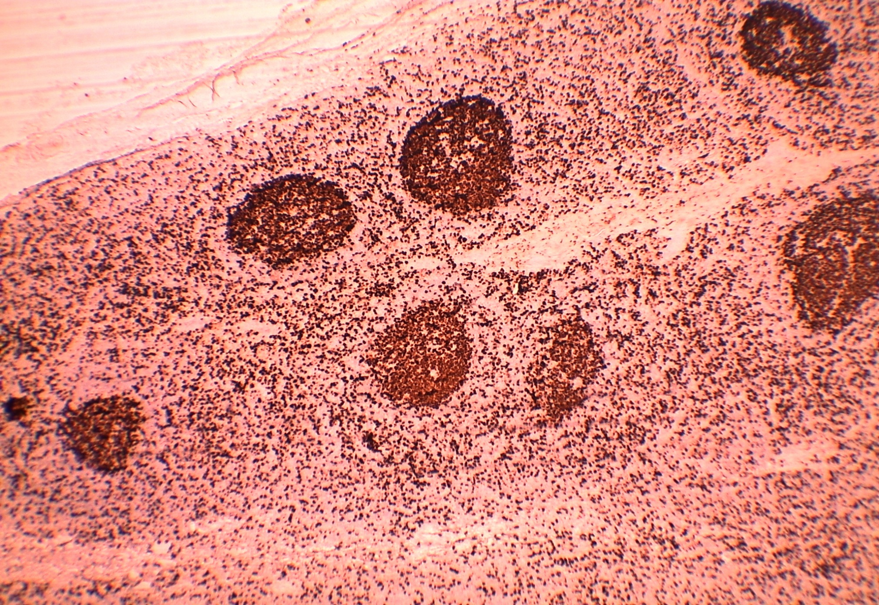
Ki67 CONTROL

Slide 8
POTENTIAL USES OF Ki67 ASSESSMENT
Prognosis
Prediction of relative responsiveness or resistance to chemotherapy / endocrine therapy
Estimation of residual risk in patients on standard therapy
Biomarker of treatment efficacy in samples taken before, during and after neoadjuvant therapy

Slide 9
Ki67
Percentage of Ki67 positive tumour cell determined by IHC used to stratify patients into good and poor prognostic groups
HOWEVER
Lack of consensus
  On scoring
  Definition of low vs high expression
  Appropriate cut off point for positivity
  Which part of the tumour should be scored eg. leading edge, “hot spots”or overall average
  Paucity of data on the effects of preanalytical variables eg. length of fixation, antigen retrieval, cold ischaemia time

Slide 10
Ki67
THEREFORE
Routine testing of breast cancers for Ki67 expression is not currently recommended by either ASCO or National Comprehensive Cancer Network (NCCN)

Slide 11
BREAST CANCER CLASSIFICATION
Heterogenous disease
Gene expression studies identified distinct molecular subtypes
  Luminal A
  Luminal B
  HER2 enriched
  Basal like
  Markedly different behaviour and prognosis
  IHC surrogate markers have been introduced for molecular classification

Slide 12
BREAST CANCER CLASSIFICATION
Luminal A – 40% of breast cancer
  ER / PR positive
  HER2 negative
  Low Ki67 index
Luminal B – 20%
  ER / PR positive
  HER2 positive (or negative)
  High Ki67 index
HER2 enriched – 10-15%
  ER / PR negative
  HER2 positive
Basal like (triple negative) – 15-20%
  ER/PR/HER2 - negative
Proposed Ki67 cut point of 14% to separate Luminal A from Luminal B.

Slide 13
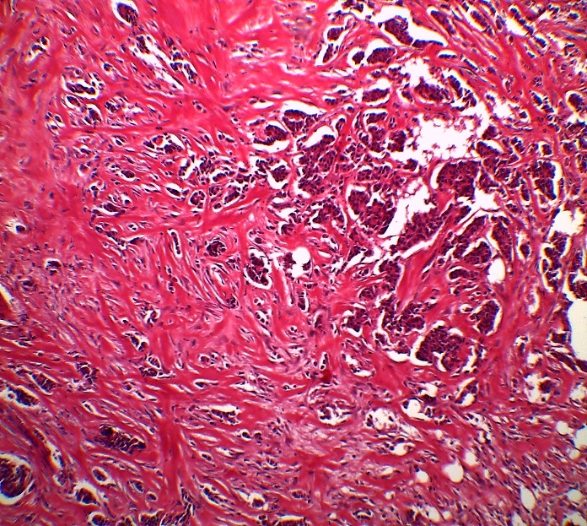
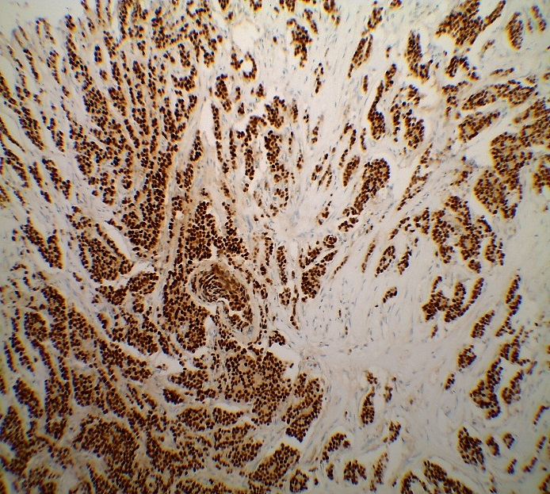
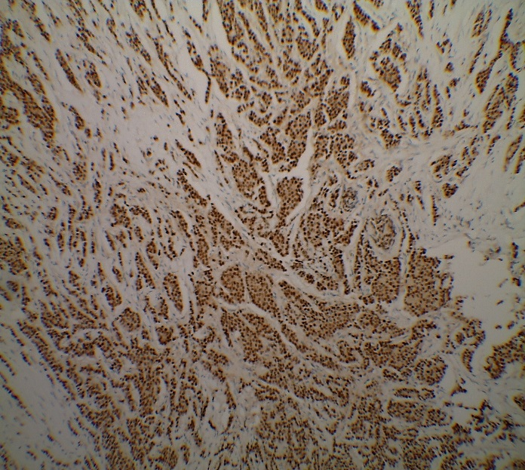
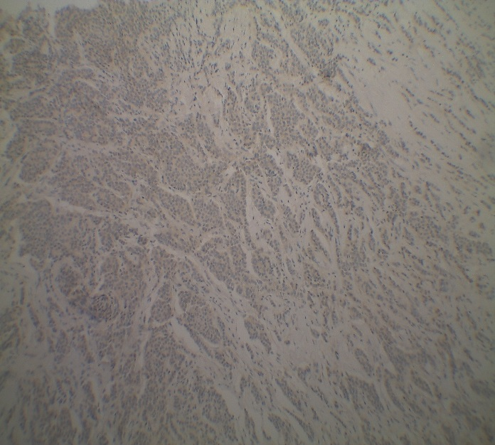
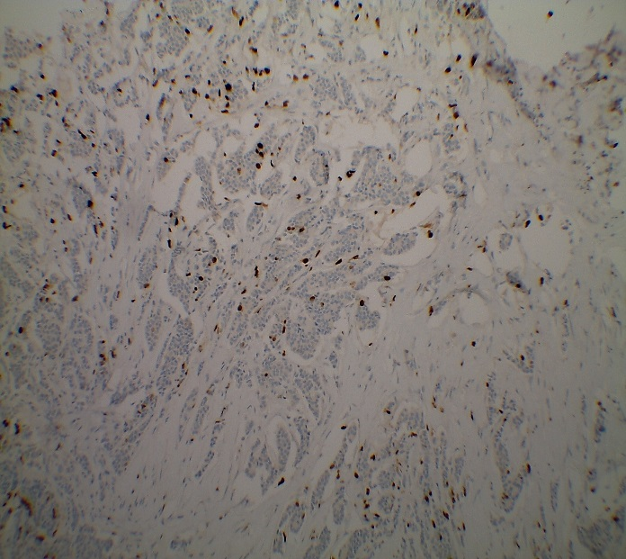
LUMINAL A
ER
PR
HER2
Ki67 (8%)

Slide 14
BREAST CANCER CLASSIFICATION
Luminal A – 40% of breast cancer
  ER / PR positive
  HER2 negative
  Low Ki67 index
Luminal B – 20%
  ER / PR positive
  HER2 positive (or negative)
  High Ki67 index
HER2 enriched – 10-15%
  ER / PR negative
  HER2 positive
Basal like (triple negative) – 15-20%
  ER/PR/HER2 - negative
Proposed Ki67 cut point of 14% to separate Luminal A from Luminal B.

Slide 15
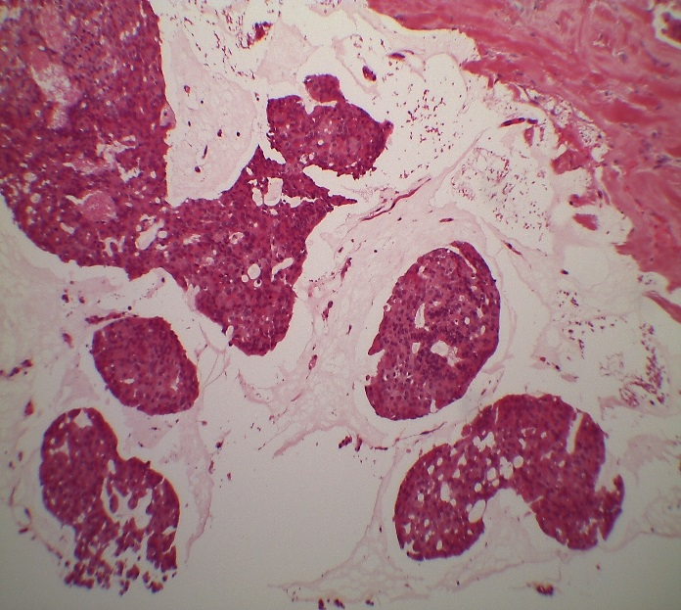
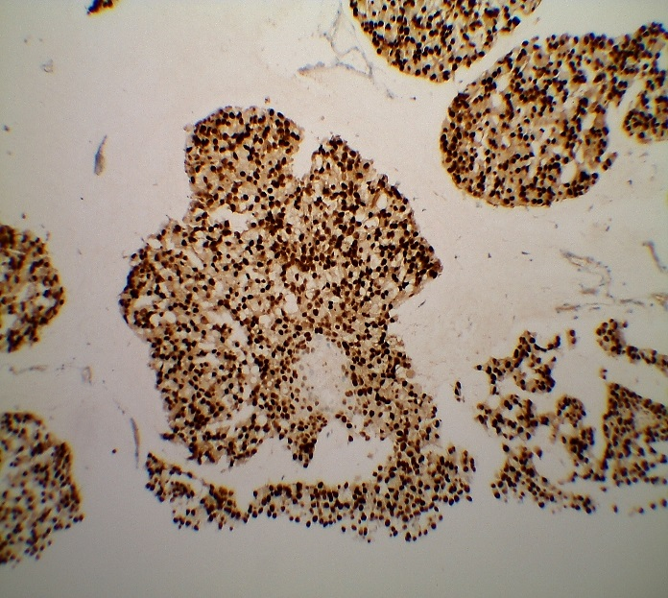
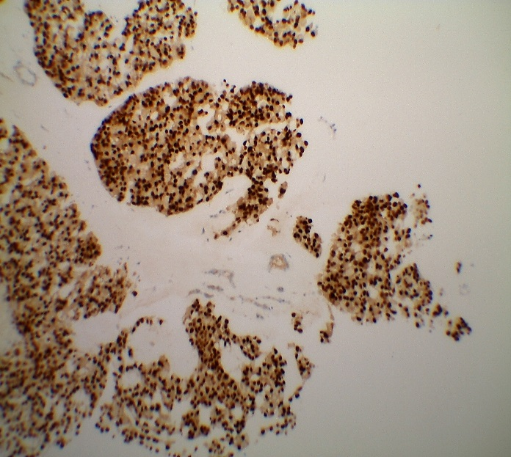
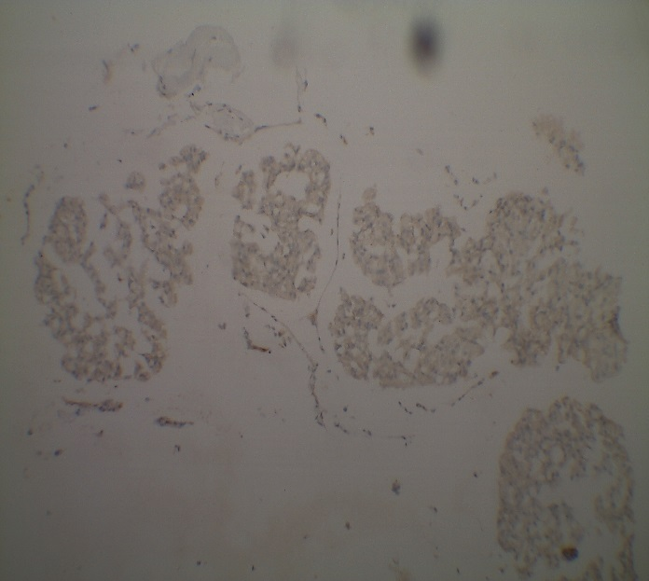
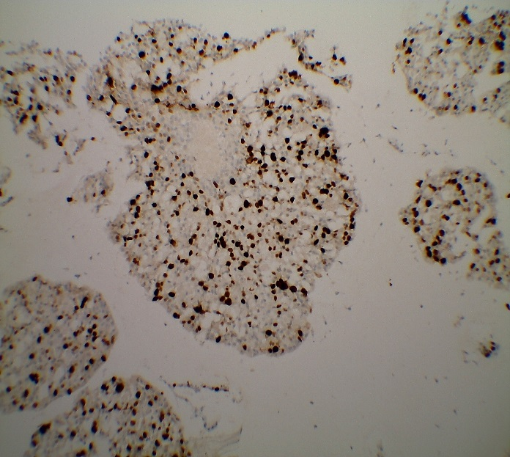
LUMINAL B
ER
PR
HER2
Ki67 (30%)

Slide 16
BREAST CANCER CLASSIFICATION
Luminal A – 40% of breast cancer
  ER / PR positive
  HER2 negative
  Low Ki67 index
Luminal B – 20%
  ER / PR positive
  HER2 positive (or negative)
  High Ki67 index
HER2 enriched – 10-15%
  ER / PR negative
  HER2 positive
Basal like (triple negative) – 15-20%
  ER/PR/HER2 - negative
Proposed Ki67 cut point of 14% to separate Luminal A from Luminal B.

Slide 17
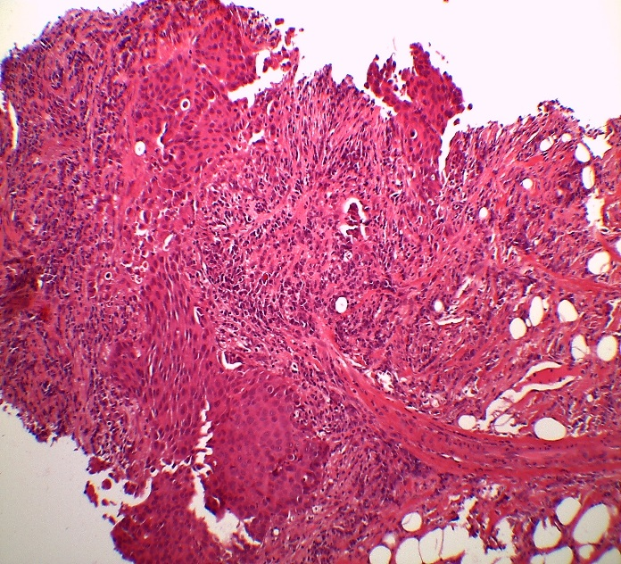
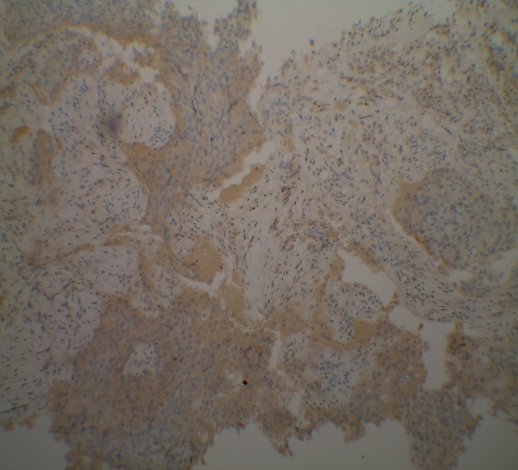
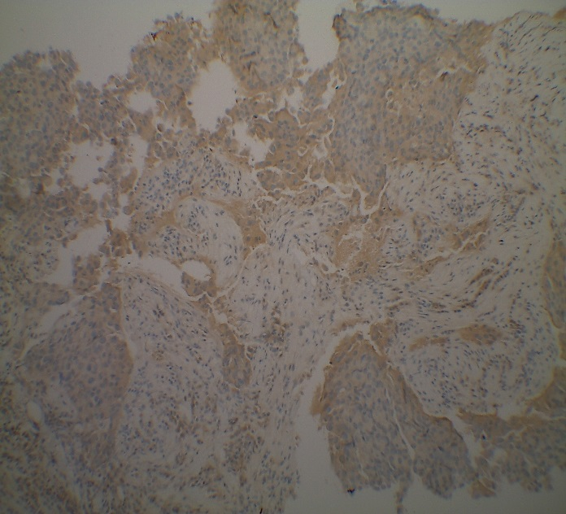
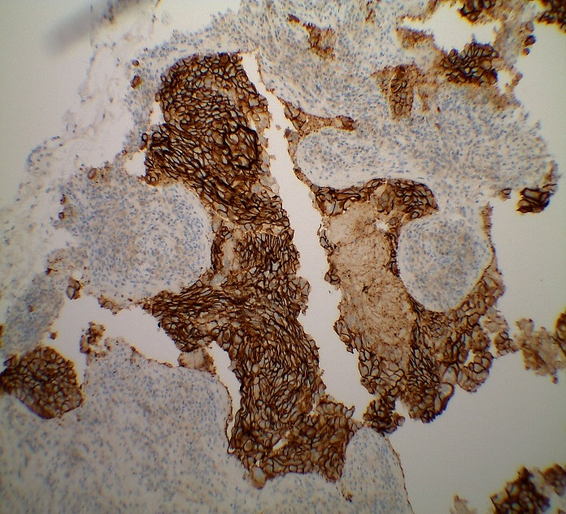
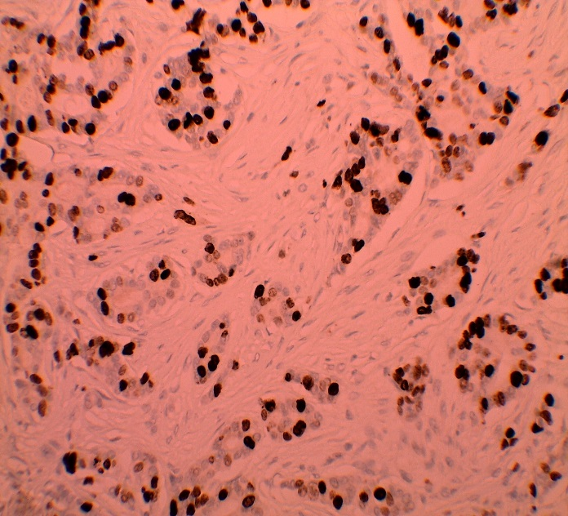
HER2 ENRICHED
ER
PR
HER2
Ki67 (50%)

Slide 18
BREAST CANCER CLASSIFICATION
Luminal A – 40% of breast cancer
  ER / PR positive
  HER2 negative
  Low Ki67 index
Luminal B – 20%
  ER / PR positive
  HER2 positive (or negative)
  High Ki67 index
HER2 enriched – 10-15%
  ER / PR negative
  HER2 positive
Basal like (triple negative) – 15-20%
  ER/PR/HER2 - negative
Proposed Ki67 cut point of 14% to separate Luminal A from Luminal B.

Slide 19
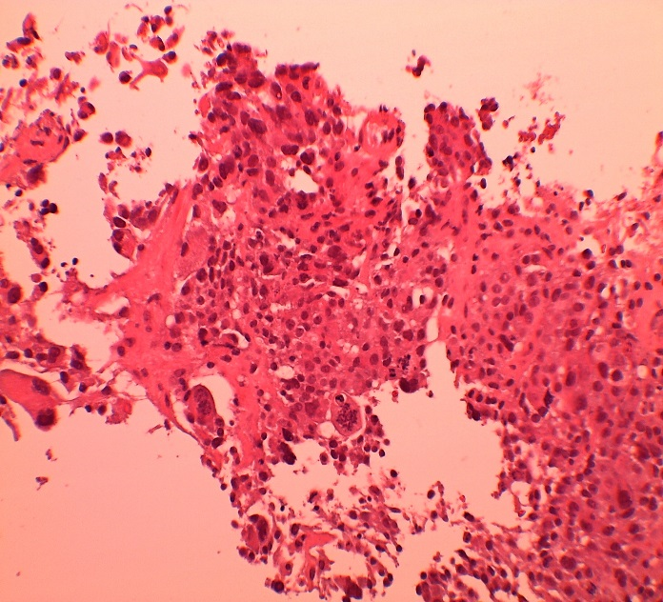
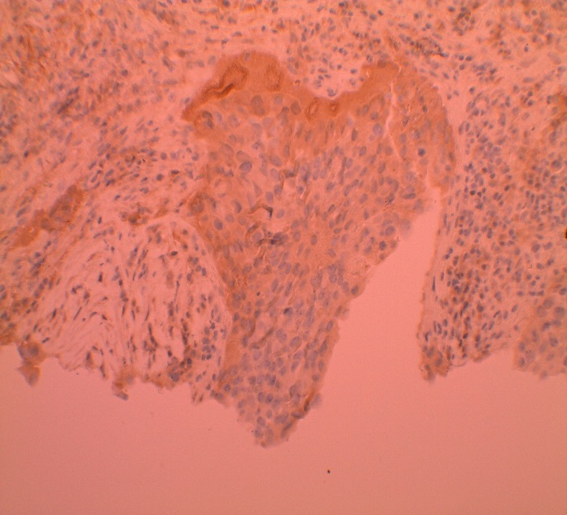
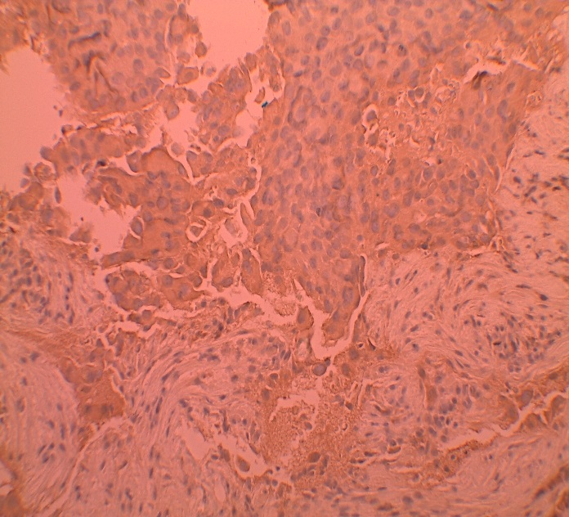
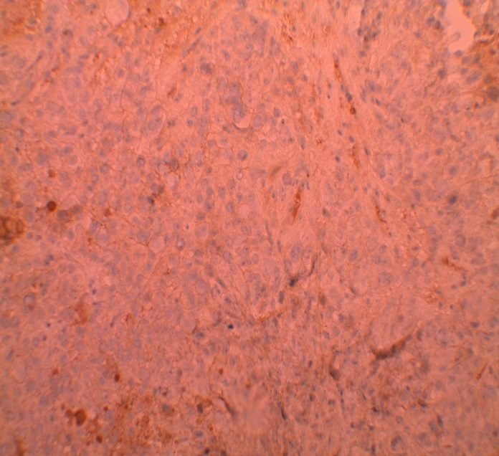
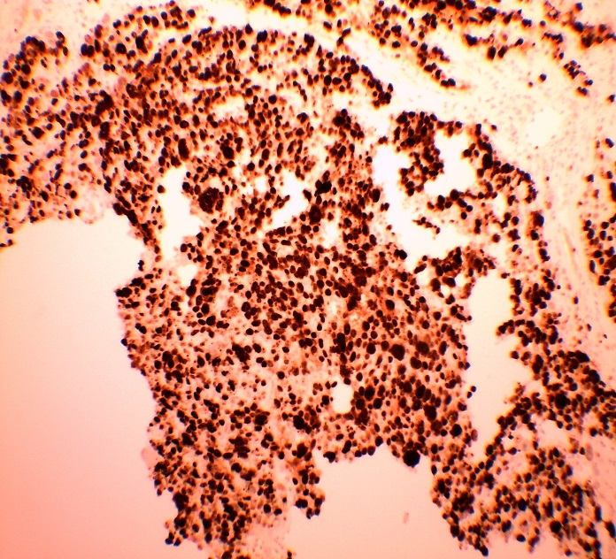
TRIPLE NEGATIVE
ER
PR
HER2
Ki67 (80%)

Slide 20
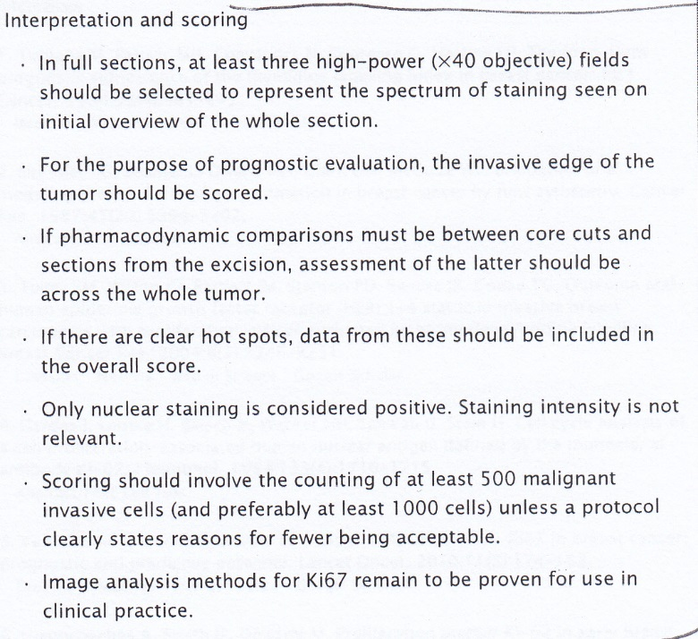

Slide 21
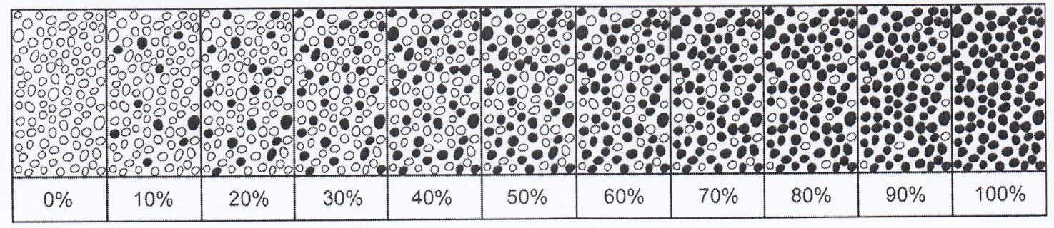
Quantification of immunohistochemical findings
The percentage of positive cells can be visually estimated

Slide 22
Ki 67 - REVIEW
AYLWYN MANNELL
UNIVERSITY WITWATERSRAND
JOHANNESBURG

Slide 23
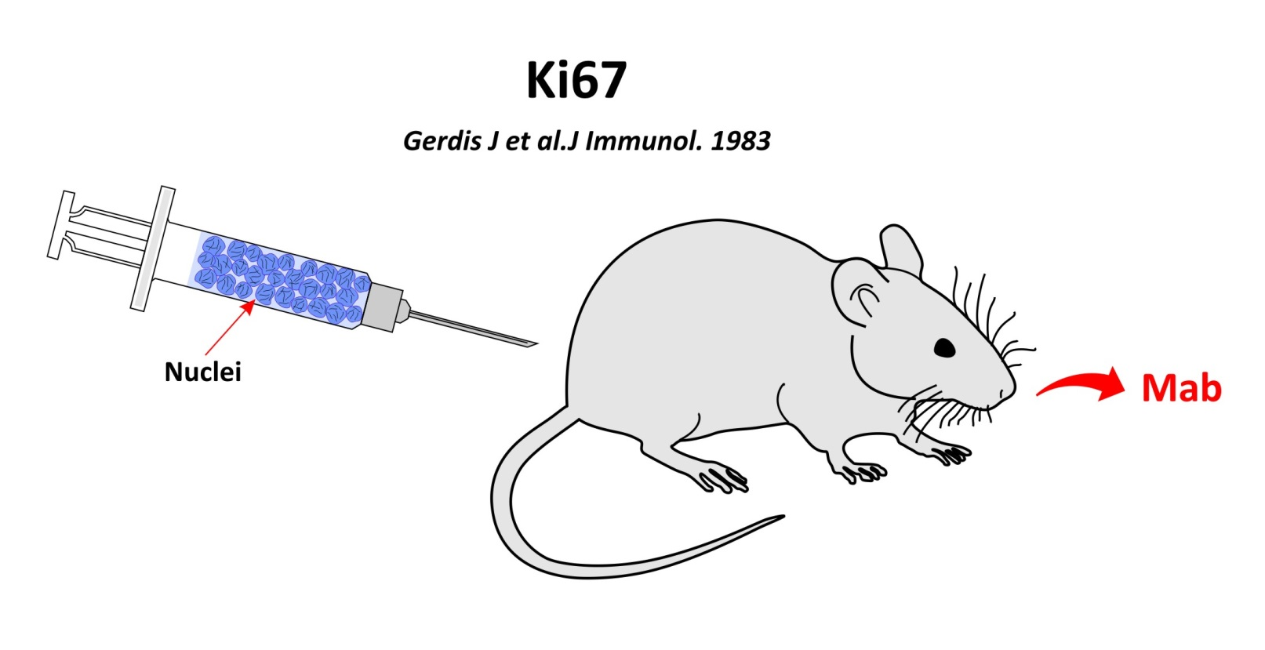

Slide 24
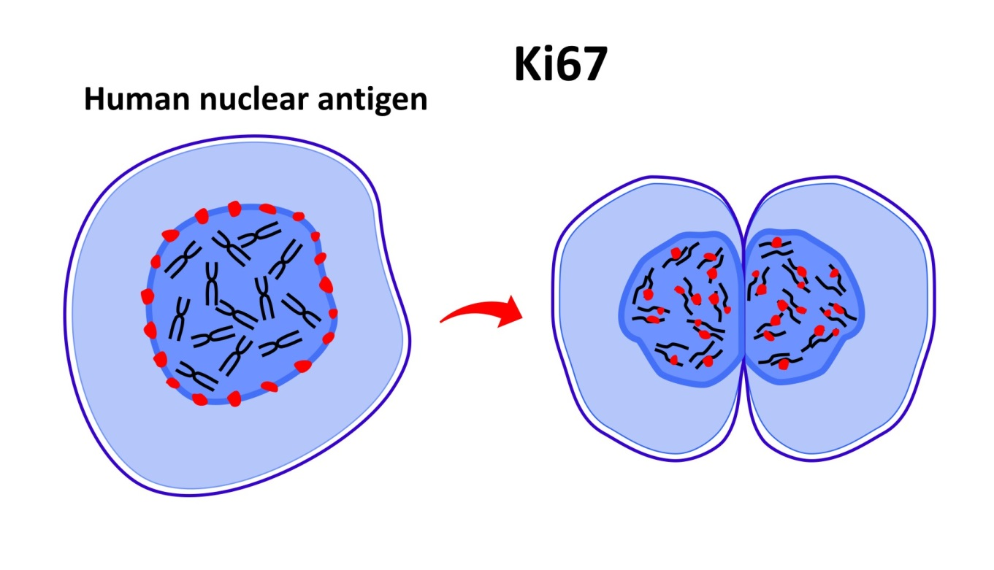
Ki67%
Growth fraction of neoplastic cell population

Slide 25
Ki 67 PROGNOSTIC MARKER
Inwald, EC et al Breast Cancer Res Treat, June 2013
3658 cases invasive breast cancer 2005 – 2011
Ki67 DFS OS
< 15% 86.7% 89.3%
> 45% 75.8% 82.8%

Slide 26
Ki67 AND HISTOPATHOLOGICAL PARAMETERS
Inwald, EC et al Breast Cancer Res Treat, June 2013
positive nodes
High Ki67 grade
ER negative
Her2 ++
“Ki67 in “Breast Cancer”
Working party

Slide 27
Ki67 and Racial difference
Breast Cancer
Ayodeji O et al, Oncology 2013
Cohort study in Nigerian/UK grade matched
high Ki67 Nigerian > UK
Race predicted OS MR Nigerian women
Independent T, N, ER
Afro-American Vs non-hispanic white
high Ki67 high MR
Morris GJ et al, Cancer 2007

Slide 28
Ki67 : MOLECULAR SUBTYPES BREAST CANCER
Cheang et al, J NCI (2009)
Luminal A Ki67 < 13.25%
Luminal B Ki67 > 13.25%
Cut point
High risk vs low risk

Slide 29
RISK OF DISTANT RECURRENCE AT 5 YRS IN EARLY BREAST CANCER
IHC₄ vs GHI – RS
Cusick J et al, J Clin Oncol 2011
ER, PR, Ki67, Her2
21-gene genomic health recurrence score
(“oncotype – DX”)

Slide 30
IHC₄
1125 ER+ve early breast cancer patients (ATAC) node negative
Same prognostic information as GHI-RS
“State of art in clinical routine” (St Gallen, 2013)
No delay, 48 hrs vs 18 months (Gov)
cost effective R2000 vs R30 000

Slide 31
LATE Recurrence in ER postive Breast Cancer
Sestak I et al JCNI, 2013
ATAC trial patients at 5 – 10 years
Recurrence scores
CTS (no chemo – anti E+
IHC₄, oncotype DX, PAM50
Risk distant metastases
Strongest prognostic factors
nodal status, tumour size
Strongest molecular score
PAM 50
Differentiate low risk vs high risk
? extended treatment

Slide 32
MA17
Goss PE et al, N Engl J Med, 2011
Letrozole after Tamoxifen
Oestrogen receptor positive breast cancer
DFS : D.DFS
OS in node positive patients (high risk)
trial stopped early after interim analysis

Slide 33
Ki67 : Selection of Therapy
TN with high Ki67 chemotherapy
ER++ with low Ki67 hormonal therapy
Preop challenge with anti-estrogen : the response guides adjuvant therapy
Dowsett et al, J Natl Cancer Inst 2007

Slide 34
Ki67 : Assessment ontreatment Response
Impact trial : Dowsett et al, Clinical Cancer Research 2005
Changes in Ki67 after 2 and 12 weeks
Significant suppression
Arimedex Vs TMX
Significant recurrence free survival
  Arimedex Vs TMX
  Rapid evaluation
  Vs long trials
  Karolinska study, CMF

Slide 35
Ki67 : Identify Residual Risk
Jones RL et al, Breast Cancer Res Treatment 2010
Residual Cancer Ki67
highest tertile lowest tertile
5yr RFS 27% 77% p < 0.001
OS 29% 93% p < 0.007
Identifies high risk
Selection of adjuvant therapy

Slide 36
Ki67 - Conclusions
Durable antigen
proliferation index
Prognosis
Selection of therapy
Assess ontreatment response
trial regimes
Residual cancer post excision
? For further therapies

Slide 37


KI67: DOES IT COMPARE TO MOLECULAR PROFILING
ROBBIE DENT
HOPELANDS CANCER CENTRE

Slide 38

WHY DO WE NEED MOLECULAR PROFILING?
PERSONALISED MEDICINE
DIFFICULT CASES

Slide 39
MOLECULAR PROFILING OR GENE SEQUENCING
NEEDS TO HAVE:
  ANALYTICAL VALIDITY
  CLINICAL VALIDITY
  CLINICAL UTILITY
TO BE:
  PROGNOSTIC
    IDENTIFY THOSE MOST AT RISK OF RECURRENCE OR OUTCOME, INDEPENDENT OF TREATMENT
  PREDICTIVE
    PREDICT RESPONSE TO TREATMENT
http://www.uptodate.com/contents/prognostic-and-predictive-factors-in-early-non-metastatic-breast-cancer/abstract/7,8

Slide 40

MOLECULAR PROFILING OR GENE SEQUENCING
MUST PROVIDE SIGNIFICANT AND INDEPENDENT PROGNOSTIC VALUE (VALIDATED BY CLINICAL TESTING)
MUST BE FEASIBLE, REPRODUCIBLE AND WIDELY AVAILABLE WITH QUALITY CONTROL
RESULTS MUST BE EASY TO INTERPRET
MEASUREMENT MUST NOT CONSUME TISSUE NEEDED FOR OTHER TESTS (ESPECIALLY NOT REPLACE ROUTINE HISTOPATHOLOGICAL EVALUATION

Slide 41
Fit for purpose
STRONGLY PROGNOSTIC
Accurate and reliable?
Incorporated in treatment guidelines?
Predictive of chemotherapy benefit?
What is the level of evidence?
Hayes DF. Am Soc Clin Oncol Ed Book. 2008:30-34.
Simon R. J Clin Oncol. 2005;23:7332-7341.

Slide 42
LUMINAL SUBTYPES
LUMINAL A
  40% OF DUCTAL CARCINOMAS
  OESTROGEN RECEPTORS HAVE HIGH EXPRESSION
  PROGESTERONE RECEPTORS USUALLY POSITIVE
  HER2NEU LOW EXPRESSION
  LOW PROLIFERATION GENE EXPRESSION
LUMINAL B
  20% OF DUCTAL CARCINOMAS
  OESTROGEN RECEPTORS HAVE LOWER EXPRESSION
  PROGESTERONE RECEPTORS USUALLY WEKLY EXPRESSED/NEGATIVE
  VARIABLE HER2NEU EXPRESSION
  HIGHER PROLIFERATION GENE EXPRESSION
  MOST HAVE A HIGHER RECURRENCE SCORE (ONCOTYPE DX) OR POOR 70-GENE EXPRESSION PROGNOSTIC SCORE
Notes:
THESE ARE THE DIFFICULT PATIENTS THAT WE ALL SEE IN THE CLINIC
THE PATIENTS WHERE THERE IS NO ABSOLUTE INDICATION FOR ADJUVANT CHEMOTHERAPY
THE ER+; HER2NEU-; NODE NEGATIVE PATIENTS WHERE THE DECISION TO GIVE OR OMIT CHEMOTHERAPY IS NOT ALWAYS CLEAR CUT
MANY PEOPLE WILL USE THE BLOOM-RICHARDSON GRADING OF TUMOURS TO HELP GUIDE THEM
THERE IS, HOWEVER, DATA TO SHOW THAT GRADE I DISEASE CAN HAVE A HIGH RECURRENCE SCORE AND GRADE III DISEASE CAN HAVE A LOW RECURRENCE SCORE ON ONCOTYPE DX

Slide 43
GENE EXPRESSION PROFILES
ONCOTYPE DX (RECURRENCE SCORE)
MAMMAPRINT
PAM50 (RISK OF RECURRENCE SCORE

Slide 44

ONCOTYPE DX
BEST VALIDATED GENE EXPRESSION PROFILE AVAILABLE
OFFERS PROGNOSTIC INFORMATION
USE IN NODE NEGATIVE, OESTROGEN POSITIVE BREAST CANCER
USES PCR TO LOOK AT 21 GENES (16 BREAST CANCER AND 5 REFERENCE)
OPTIMISED TO PREDICT DISTANT RELAPSE DESPITE TAMOXIFEN TREATMENT
MAY PREDICT ENDOCRINE RESPONSIVENESS AND CHEMOTHERAPY RESISTANCE
Paik et al: Gene expression and benefit of chemotherapy in women with node-negative, estrogen receptor-positive breast cancer. J Clin Oncol. 2006;24(23):3726
Albain et al: Prognostic and predictive value of the 21-gene recurrence score assay in postmenopausal women with node-positive, oestrogen-receptor-positive breast cancer on chemotherapy: a retrospective analysis of a randomised trial. Lancet Oncol. 2010;11(1):55.

Slide 45
Oncotype DX Clinical Validation:
NSABP B-14, Distant Recurrence
Distant recurrence over time
100%
90%
10-Year rate of recurrence = 6.8%*
95% CI: 4.0%, 9.6%
80%
10-Year rate of recurrence = 14.3%
95% CI: 8.3%, 20.3%
70%
60%
10-Year rate of recurrence = 30.5%*
95% CI: 23.6%, 37.4%
Proportion without distant recurrence
50%
40%
All Patients, n = 668
30%
RS < 18, n = 338
20%
RS 18-30, n = 149
10%
RS ≥ 31, n = 181
P < 0.001
0%
0
2
4
6
8
10
12
14
16
RS, Recurrence Score result
Years
Paik S, et al. N Engl J Med. 2004;351:2817-2826
*10-Year distant recurrence comparison between low- and high-risk groups: P < 0.001
ONCOTYPE DX WEBSITE
Notes:
Main point: The Oncotype DX® assay is clinically validated to predict the risk of distant recurrence at 10 years in patients with ER+, node-negative breast cancer treated with tamoxifen.
The Recurrence Score® result was calculated for each patient: 51% of
the patient population fell into the low-risk group (n = 338), 22% fell into
the intermediate-risk group (n = 149), and 27% fell into the high-risk group
(n = 181).¹
This graph demonstrates the difference in distant relapse-free survival (DRFS) over time for the different risk categories. The DRFS for the high- and low-risk groups were statistically significantly different; the 10-year distant relapse-free survival for the low-risk category was 93% compared to 69% for the high-risk category.¹
Paik S, Shak S, Tang G, et al. Use of an RT-PCR assay to predict the likelihood of breast
cancer recurrence in node-negative, estrogen receptor–positive, tamoxifen-treated patients.
In preparation.

Slide 46
ONCOTYPE DX
BENEFIT FROM CHEMOTHERAPY
NSABP B-20
  PATHOLOGICALLY NODE NEGATIVE PATIENTS (n=651)
  LOOKED AT ADDITION OF CMF CHEMOTHERAPY TO TAMOXIFEN
  INCREASED RATE OF DISTANT DFS AT 10YRS IN HIGH RS PTS 88 VS 60%
SWOG 8814 (RETROSPECTIVE ANALYSIS)
  NODE POSITIVE POST MENOPAUSAL PATIENTS (n=367)
  HIGH RISK PATIENTS ON RS
  TAMOXIFEN ONLY VS FAC → TAMOXIFEN
  10 YR DFS 55 VS 43%
  OS 73 VS 54%
Paik et al: Gene expression and benefit of chemotherapy in women with node-negative, estrogen receptor-positive breast cancer. J Clin Oncol. 2006;24(23):3726
Albain et al: Prognostic and predictive value of the 21-gene recurrence score assay in postmenopausal women with node-positive, oestrogen-receptor-positive breast cancer on chemotherapy: a retrospective analysis of a randomised trial. Lancet Oncol. 2010;11(1):55.

Slide 47
High Recurrence Score Result Correlates with Greater Benefit from Chemotherapy (NSABP B-20)
1.0
Patients with high RS
28% absolute benefit from tamoxifen + chemotherapy
0.9
0.8
0.7
0.6
Proportion without distant recurrence
 |  |  | N | Events
0.5
All patients |  | Tamoxifen + chemotherapy Tamoxifen | 424 227 | 33 31 | P = 0.02
4.4% absolute benefit from tamoxifen + chemotherapy
0.4
0.3
RS < 18 |  | Tamoxifen + chemotherapy Tamoxifen | 218 135 | 8 4 | P = 0.61
0.2
RS 18-30 |  | Tamoxifen + chemotherapy Tamoxifen | 89 45 | 9 4 | P = 0.39
0.1
RS ≥ 31 |  | Tamoxifen + chemotherapy Tamoxifen | 117 47 | 13 18 | P < 0.001
0
2
4
6
8
10
12
Years
RS, Recurrence Score result
Paik S, et al. J Clin Oncol. 2006;24:3726-3734.
ONCOTYPE DX WEBSITE

Slide 48
High Recurrence Score Disease Is
Chemo-sensitive Whereas Low Recurrence Score Disease is Not (NSABP B-20)
Node Negative, ER-Positive Breast Cancer Chemotherapy Benefit
Recurrence Score vs Distant Recurrence at 10 Years
Tam vs Tam + CMF/MF
Absolute Benefit of Chemotherapy (CMF/MF) at 10 Years
by Recurrence Score Group
50%
50%
45%
Rate: Tam
95% Cl: Tam
Rate: Tam + CMF/MF
95% Cl: Tam + CMF/MF
40%
40%
35%
Tam
30%
30%
Average Rate of Distant Recurrence at 10 Years
25%
20%
20%
% Decrease in Distant Recurrence at 10 Years (mean ± SE)
15%
Tam +
CMF/MF
10%
10%
5%
0%
0%
0
5
10
15
20
25
30
35
40
45
50
Breast Cancer Recurrence Score
-10%
Recurrence Score
< 18
(n = 353)
Recurrence Score
18 - 30
(n = 134)
Recurrence Score
≥ 31
(n = 164)
ONCOTYPE DX WEBSITE
Notes:
The figures in this slide correspond to the second page of the Oncotype DX report. These are two graphical representations of the chemotherapy benefit data derived from NSABP B-20. The graph on the left represents the RS as a continuous variable. The graph on the right represents the RS as a categorical variable (i.e. risk groups).
Both graphs show that the highest benefit form chemotherapy is derived by the high RS disease group.

Slide 49
MAMMAPRINT
PROGNOSIS IN PATIENTS REGARDLESS OF HORMONE RECEPTOR STATUS AND IN PATIENTS WITH HER2NEU+ DISEASE
LOW QUALITY DATA TO SHOW CLINICAL VALIDITY
MINDACT (Microarray In Node negative Disease may Avoid ChemoTherapy)
  ONGOING TRIAL (ACCRUAL IS COMPLETE)
  NODE NEGATIVE PATIENTS
  AFTER CLINICAL RISK ASSESSMENT
    ONCOTYPE DX AND MAMMAPRINT IS DONE
    DISCORDANT CLINICAL ASSESSMENT AND GENOMIC PROFILE RANDOMISED TO ADJUVANT CHEMOTHERAPY OR NOT
http://www.uptodate.com/contents/prognostic-and-predictive-factors-in-early-non-metastatic-breast-cancer/abstract/78

Slide 50
PAM50 (RISK OF RECURRENCE SCORE)
50-GENE TEST
NODE NEGATIVE AND NODE POSITIVE DISEASE
STRATIFY ER+ TUMOURS INTO HIGH, INTERMEDIATE AND LOW RISK
PROGNOSTIC INFORMATION NOT PREDICTIVE
Gnant M, Filipits M, Mlineritsch B et al. Clinical validation of the PAM50 risk of recurrence (ROR) score for predicting residual risk of distant-recurrence (DR) after endocrine therapy in postmenopausal women with ER+ early breast cancer (EBC): An ABCSG study. Cancer Res 2012; 72:P2-10-02.

Slide 51
PROGNOSTIC FACTORS UNDER INVESTIGATION
NOT TO BE USED IN ROUTINE CLINICAL PRACTICE
  76-GENE TUMOUR PROFILE
  ICH4 INDEX
  GENOMIC GRADE INDEX
  BREAST CANCER INDEX
  MARKERS OF PROLIFERATION
  CIRCULATING TUMOUR CELLS
http://www.uptodate.com/contents/prognostic-and-predictive-factors-in-early-non-metastatic-breast-cancer/abstract/88

Slide 52
KI67
META-ANALYSIS OF 46 TRIALS WITH 12 000+ PATIENTS
  HIGH KI67
    HIGHER RISK OF RELAPSE IN NODE + AND NODE – DISEASE
    WORSE SURVIVAL IN NODE + AND NODE – PATIENTS
  PROBLEMS
    HETEROGENEITY AND INCONSISTENCY IN RETROSPECTIVE STUDIES
    METHODOLOGICAL ISSUES IN LAB REAGENTS, PRCEDURES AND SCORING
ASCO GUIDELINES
  DO NOT USE FOR PROGNOSIS
Cardosa et al: Ki-67 as prognostic marker in early breast cancer: a meta-analysis of published studies involving 12,155 patients. Br J Cancer. 2007;96(10):1504.

Slide 53
KI67
SAHEBJAM ET AL HAVE SHOWN THAT TUMOURS WITH A HIGH KI67 ARE MORE LIKELY TO HAVE A HIGHER RECURRENCE SCORE IN ONCOTYPE DX TESTING BUT IT IS NOT THE SOLE DETERMINANT
THERE IS NO EVIDENCE FOR IT’S USE IN NODE POSITIVE BREAST CANCER
THEREFORE IN A RESOURCE CONSTRAINED ENVIRONMENT WE CAN PROBABLY USE KI67 TO HELP ELUCIDATE LUMINAL B TUMOURS AND USE THIS AS AN ADJUNCTIVE IN DECIDING ON WHETHER TO RECOMMEND ADJUVANT CHEMOTHERAPY IN THE ABSENCE OF ABSOLUTE INDICATIONS FOR ADJUVANT CHEMOTHERAPY
Sahebjam et al: Ki 67 is a major, but not the sole determinant of Oncotype Dx recurrence score. British Journal of Cancer (2011) 105, 1342-1345
Andre et al: Nat Rev Clin Oncol. 12, 296-301 (2015)

Slide 54
CONCLUSION
ONCOTYPE DX REMAINS THE ONLY GENE SEQUENCING PROFILE RECOMMENDED IN ALL GUIDELINES (ESMO, ST GALLEN, ASCO, NICE, NCCN) FOR NODE NEGATIVE PATIENTS
AT THIS STAGE IT IS STILL UNCERTAIN AS TO WHICH CUT-OFF OF RS SHOULD BE USED TO ADMINISTER OR NOT ADMINISTER CHEMOTHERAPY
GENE SEQUENCE PROFILING IS REPRODUCIBLE AND CLINICALLY USEFUL
KI67 IS VARIABLE EVEN IN THE BEST LABS IN THE WORLD
NEITHER SHOULD REPLACE CLINICAL AND GOOD HISTOPATHOLOGICAL INFORMATION
USE AN ADJUNCTIVE IN SMALL GROUP OF PATIENTS
  ER+HER2NEU- AND NODE NEGATIVE
Mei-Yin et al: An International Ki67 Reproducibility Study. JNCI November 2013

Slide 55

Breast Cancer Forum
18 August 2015

Slide 56



Sharing the Burden
Objectives achieved through:
Corporate Social Investment Projects
Patient Access Programmes
Company confidential August 2015

Slide 57
Corporate Social Investment Accomplishments
Oncology pharmacy at Charlotte Maxeke Hospital, Johannesburg – Aug 2011; R320k
Refurbishment of oncology ward National Hospital, Bloemfontein – Sept 2012; R1.6mil
Moved bio-hazard cabinet at Chris Hani Baragwaneth Hospital, Johannesburg – May 2013; R85k
Opened Nurses Lounge and Education Centre at PE Provincial Hospital, Port Elizabeth – April 2015; R150k
Oncology Nurse skills enhancement is the focus for 2015
Aims - to refurbish state cancer facilities
and enhance oncology nursing skills

Slide 58
Patient Access Programmes
Eligibility criteria common to all programmes:
  Clinical decision made by doctor prior to ICCF involvement
  South African patients
  Affordability challenge such that treatment would be interrupted / stopped without ICCF support
  Registered indications
  Drugs sold at the single exit price

Slide 59
Patient Access Programmes in place
Bevacizumab Programme:
  threshold is 60mg/kg
  ICCF pays co-payment or in full
  helped 51 patients YTD
Breast Cancer Programme:
  Everolimus:
    ICCF pays up to 20% depending on funder;
  Trastuzumab:
    threshold of 85mg/kg
    ICCF pays for the next 4 cycles either in full or co-pay
Multiple Sclerosis Programme:
  amount ICCF pays varies depending on funding levels for Fingolimod

Slide 60
Process map of Patient Access Programme
TREATMENT DECISION
ICCF AUTHORISATION
PHARMACY NOTIFICATION
DISPENSING AND INVOICING
Doctor discusses options and
costs as per NHA
ICCF Manager provides access to PAP forms
ICCF Manager notifies practice pharmacy of:
- approval of patient and approval date
- funding level from the ICCF
- duration of approval (where applicable)
- product sold at the SEP
Practice orders from the pharmacy when patient is die for treatment
Patient consents
to treatment
Doctor submits screening
form to ICCF Manager
Patient receives treatment in the rooms as normal
Practice contacts ICCF to find out more about PAP and eligibility criteria
If eligibility criteria match, ICCF Manager directs doctor to PDF forms
Pharmacy dispenses meds and invoices the ICCF and funder in line with scheme benefits and funding level for the product
Doctor submits PDF forms to ICCF Manager for review
Liaison between clinical expert, ICCF Manager and Doctor
ICCF Manager notifies Doctor whether patient is approved or not

Slide 61
Process map of Patient Access Programme
TREATMENT DECISION
FUNDER PAYS IN FULL
PATIENT CAN AFFORD CO-PAY
PATIENT CAN’T AFFORD TO PAY
APPLY TO ICCF
DECLINED
e.g. tx not per registered indication
APPROVED
PHARMACY NOTIFICATION
DISPENSE AND INVOICE ICCF

Slide 62

Innovative Cancer Care Foundation
www.iccf.co.za
Jeanette Schwegman
Email: jeanette@iccf.co.za
Cell: 082 600 8472

